Slide 1
Chapter 5 Control Statements: Part 2; Logical Operators
Java How to Program, 11/e
Questions? E-mail paul.deitel@deitel.com

Slide 2
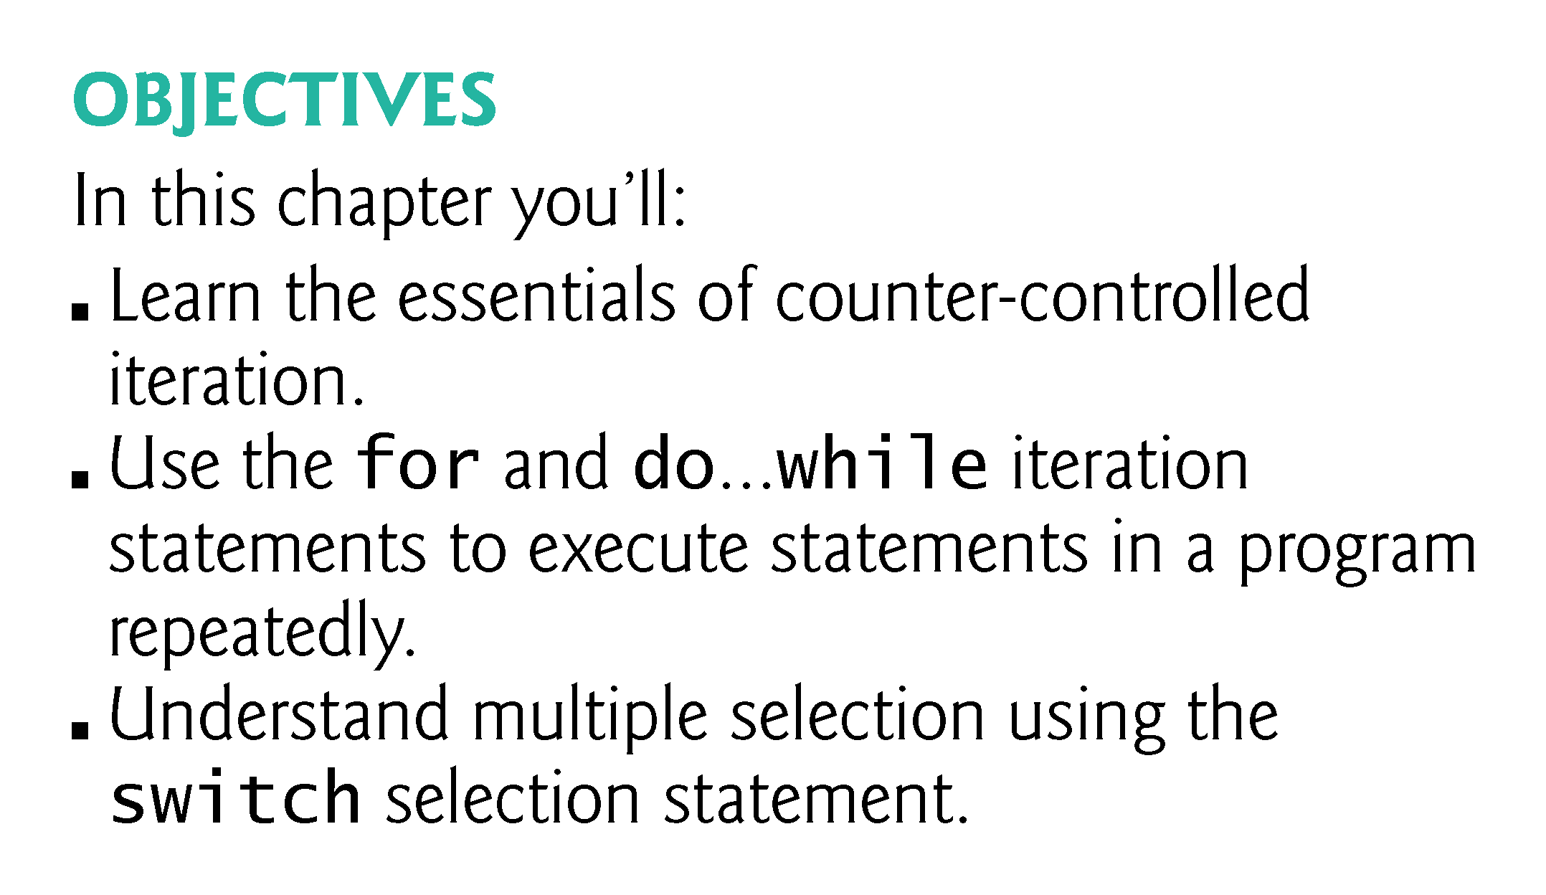

Slide 3
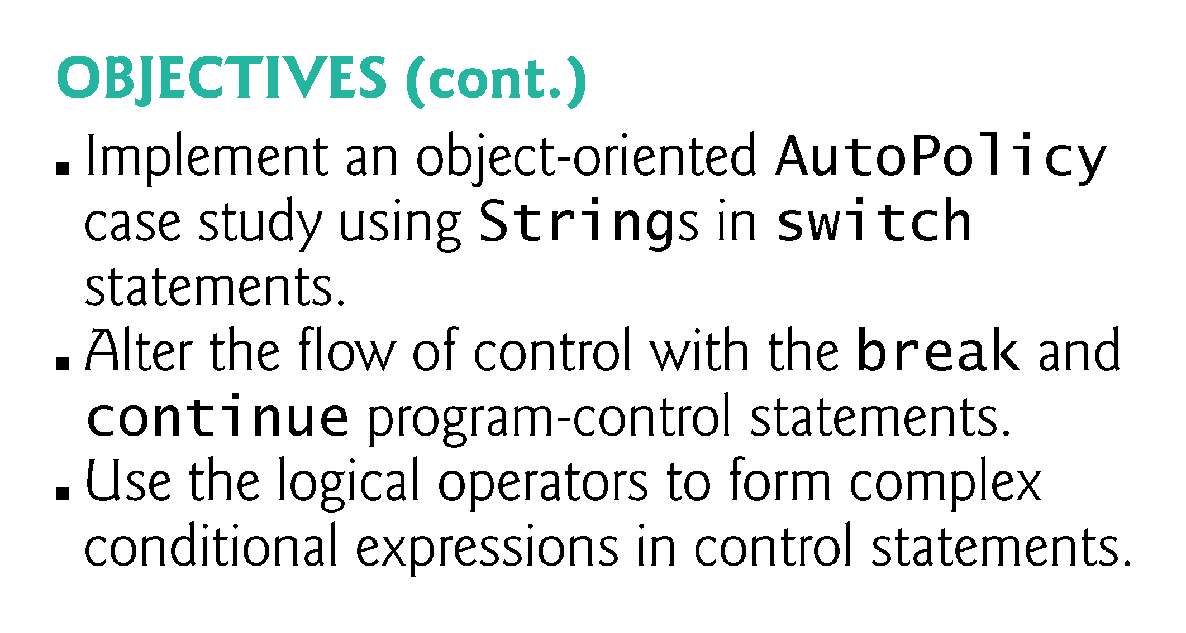

Slide 4
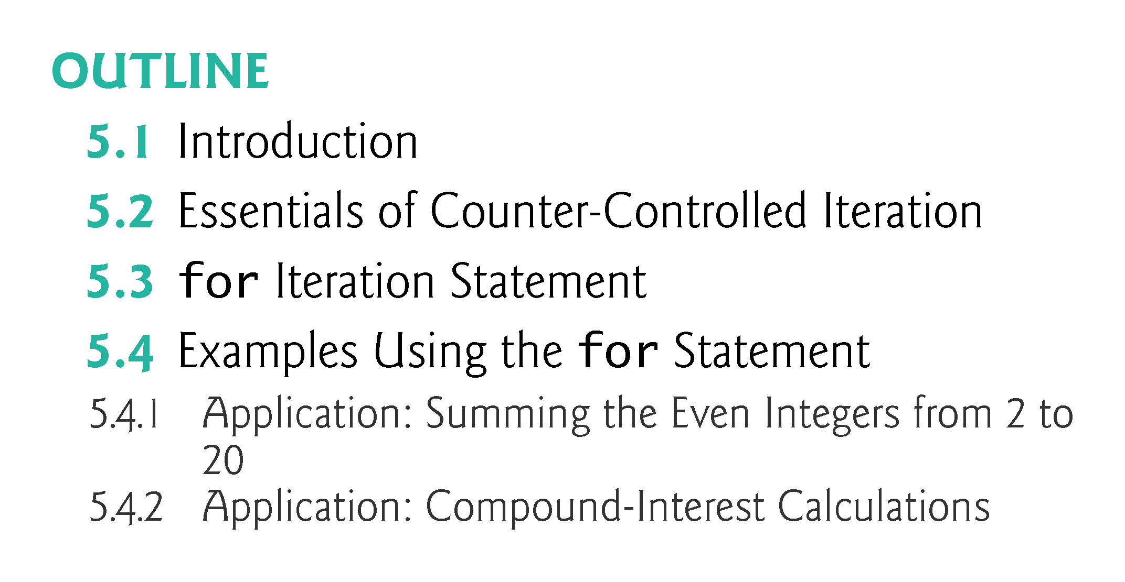

Slide 5
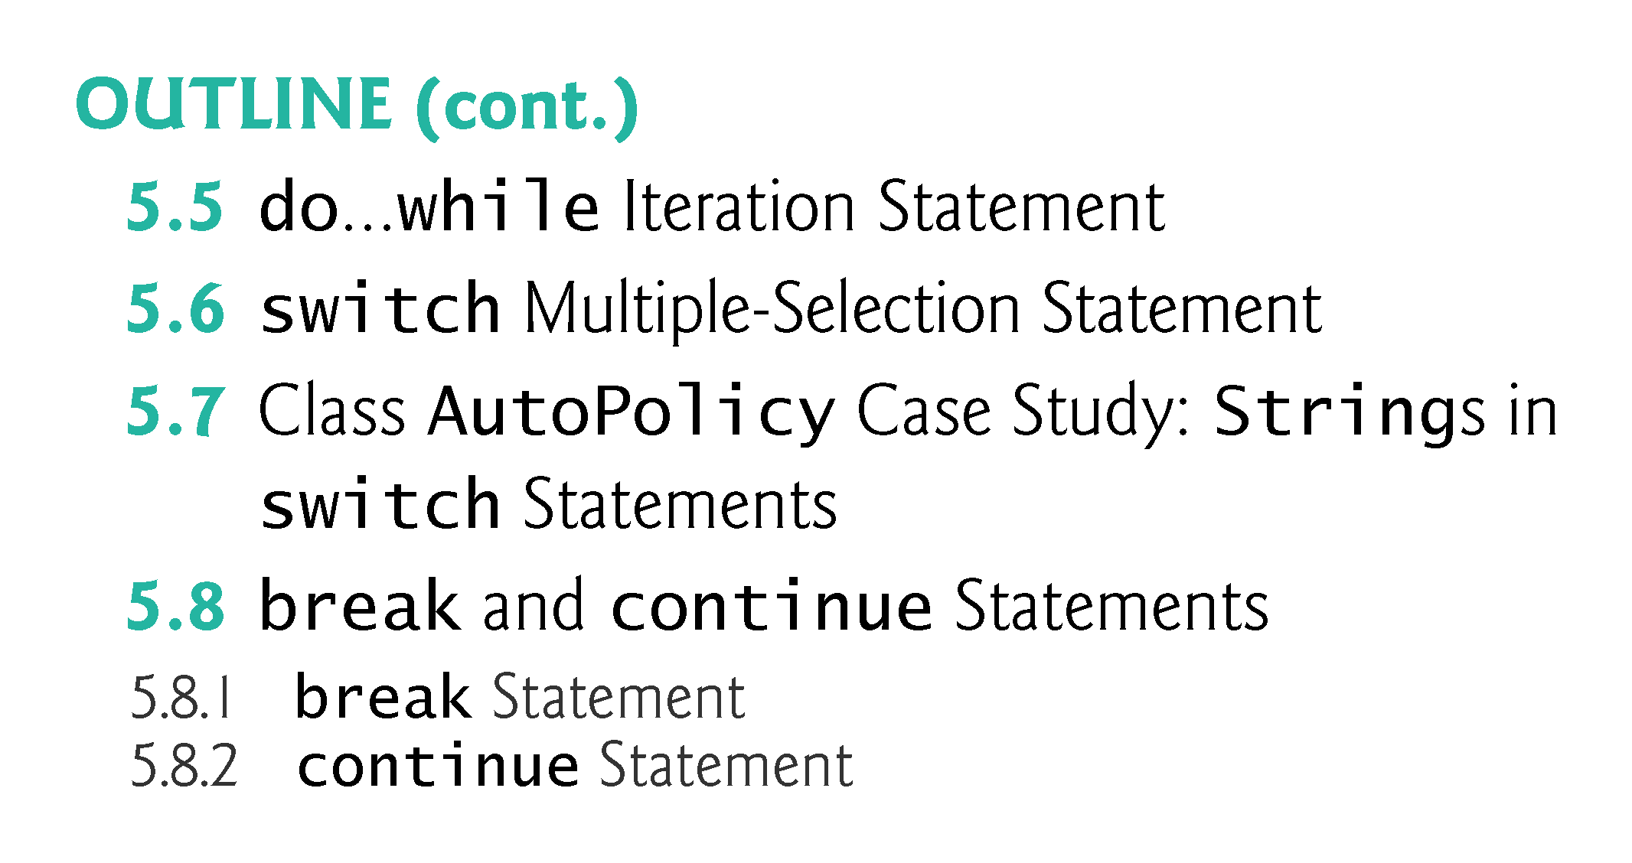

Slide 6
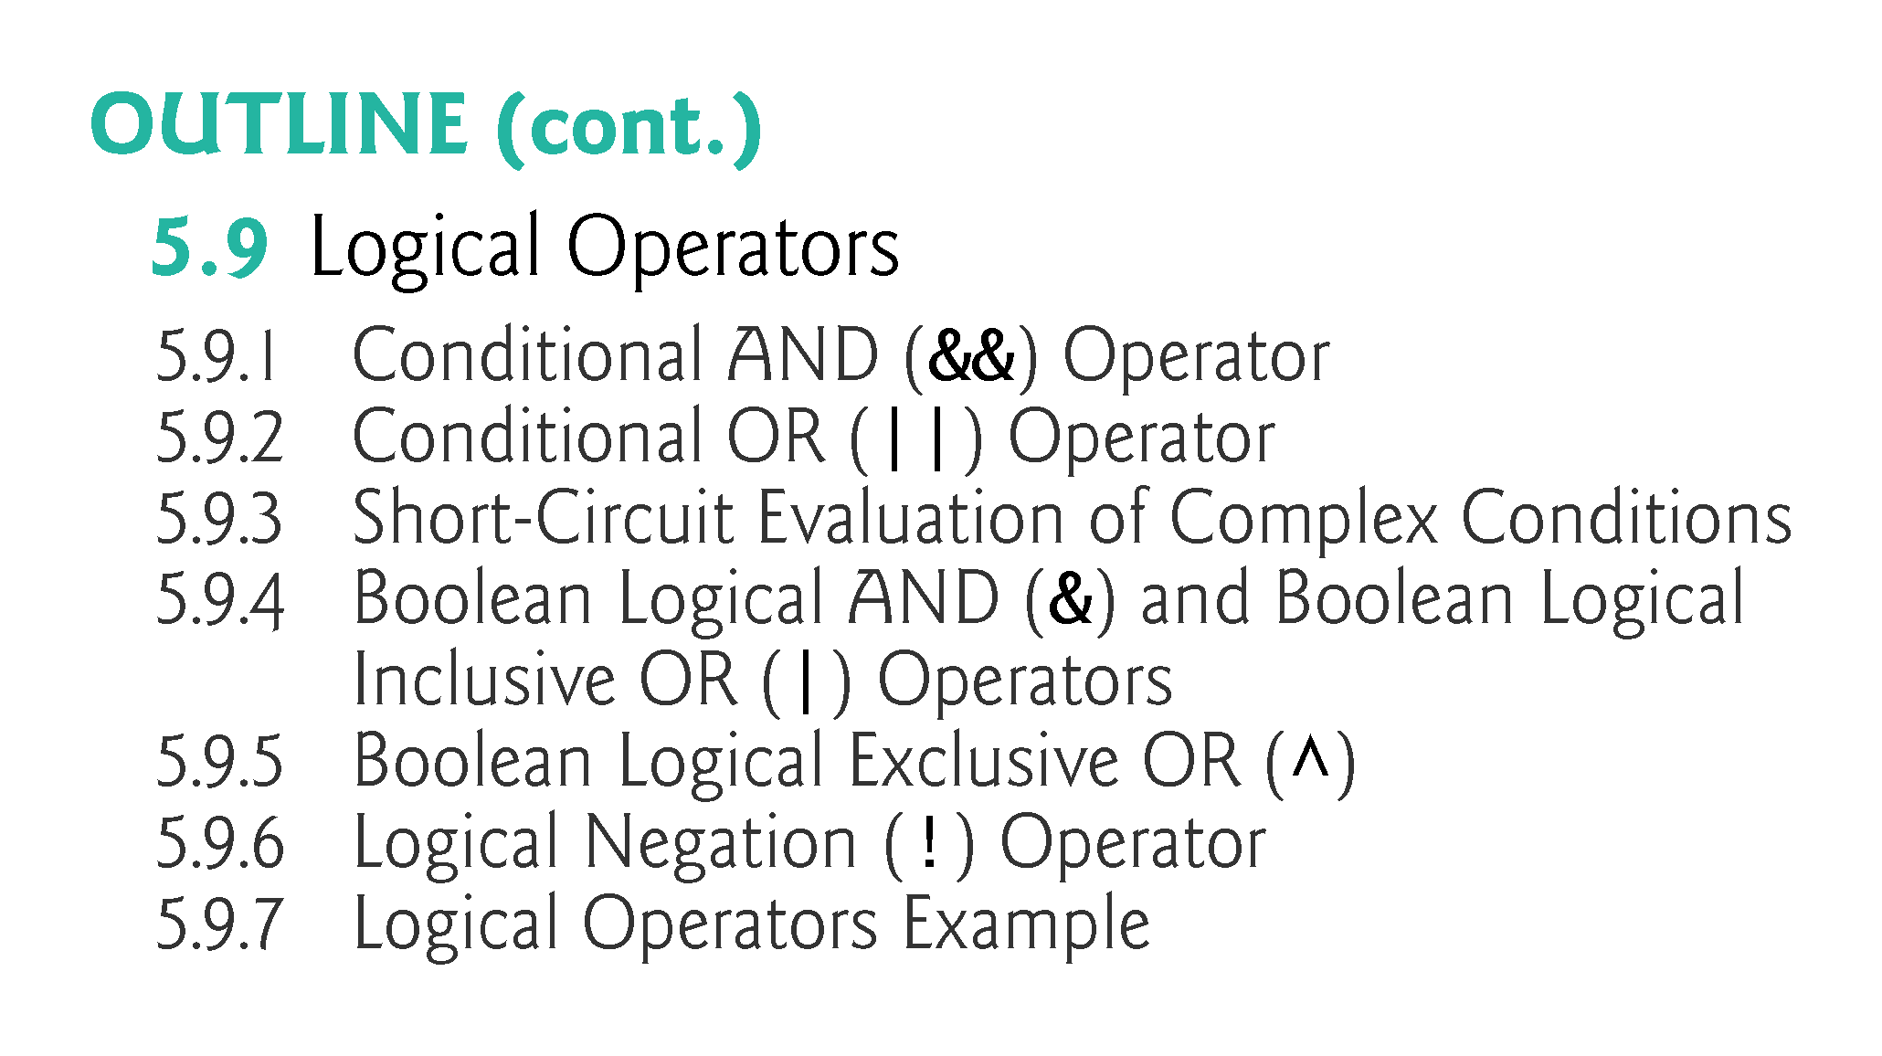

Slide 7
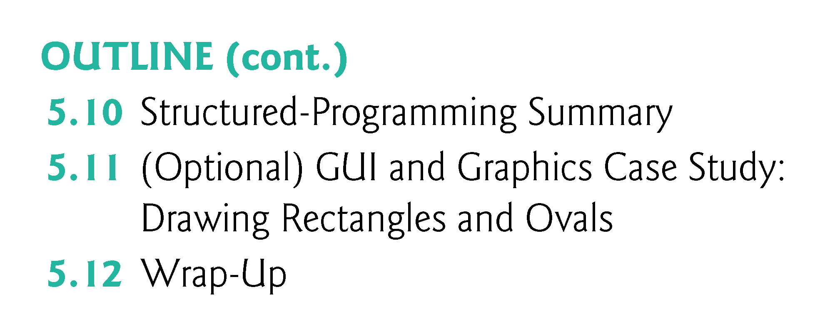

Slide 8
5.1 Introduction
for iteration statement
do…while iteration statement
switch multiple-selection statement
break statement
continue statement
Logical operators
Control statements summary.

Slide 9
5.2 Essentials of Counter-Controlled Iteration
Counter-controlled iteration requires
a control variable (or loop counter)
the initial value of the control variable
the increment by which the control variable is modified each time through the loop (also known as each iteration of the loop)
the loop-continuation condition that determines if looping should continue.

Slide 10
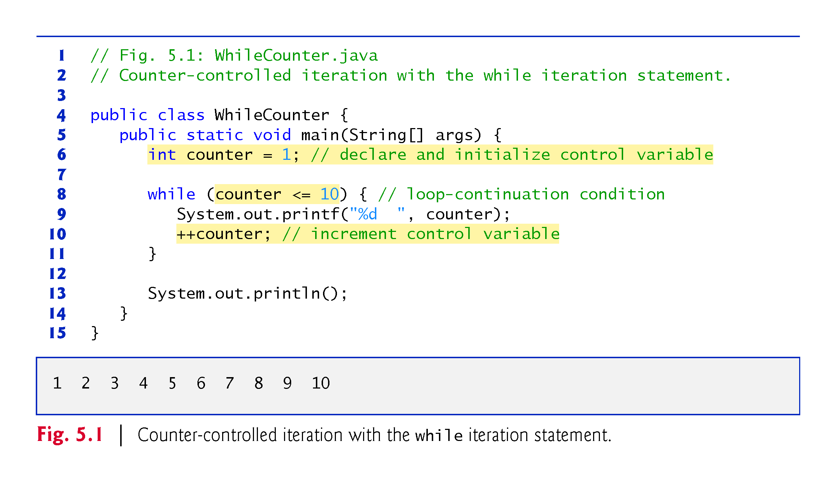

Slide 11
5.2 Essentials of Counter-Controlled Iteration (Cont.)
In Fig. 5.1, the elements of counter-controlled iteration are defined in lines 6, 8 and 10.
Line 6 declares the control variable (counter) as an int, reserves space for it in memory and sets its initial value to 1.
The loop-continuation condition in the while (line 8) tests whether the value of the control variable is less than or equal to 10 (the final value for which the condition is true).
Line 10 increments the control variable by 1 for each iteration of the loop.

Slide 12
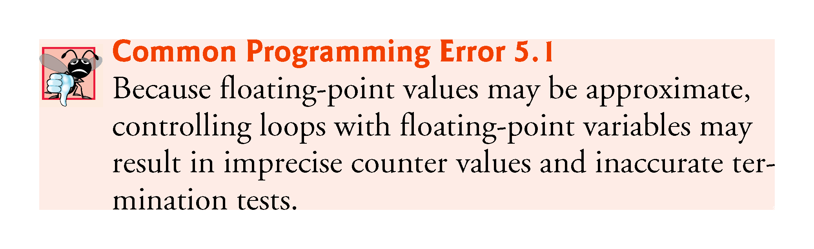

Slide 13
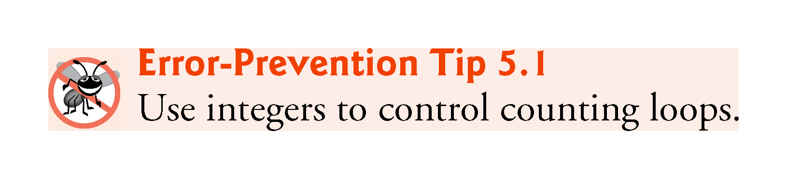

Slide 14
5.3 for Iteration Statement
for iteration statement
Specifies the counter-controlled-iteration details in a single line of code.
Figure 5.2 reimplements the application of Fig. 5.1 using for.

Slide 15
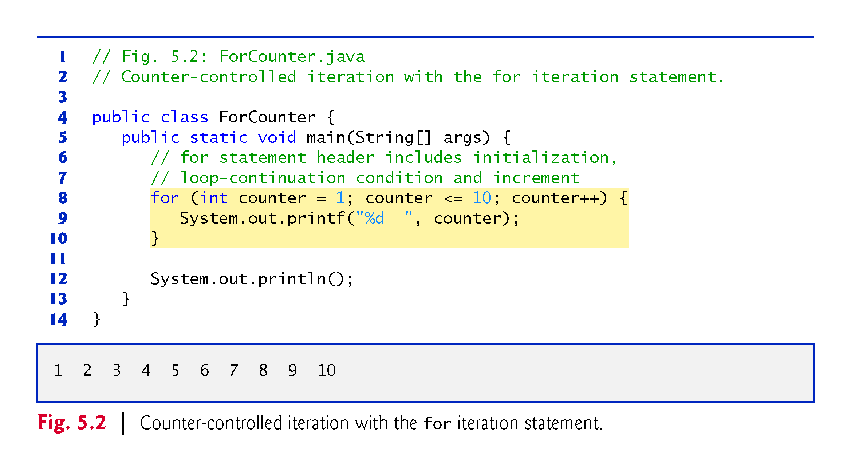

Slide 16
5.3 for Iteration Statement (Cont.)
When the for statement begins executing, the control variable is declared and initialized.
Next, the program checks the loop-continuation condition, which is between the two required semicolons.
If the condition initially is true, the body statement executes.
After executing the loop’s body, the program increments the control variable in the increment expression, which appears to the right of the second semicolon.
Then the loop-continuation test is performed again to determine whether the program should continue with the next iteration of the loop.
A common logic error with counter-controlled iteration is an off-by-one error.

Slide 17
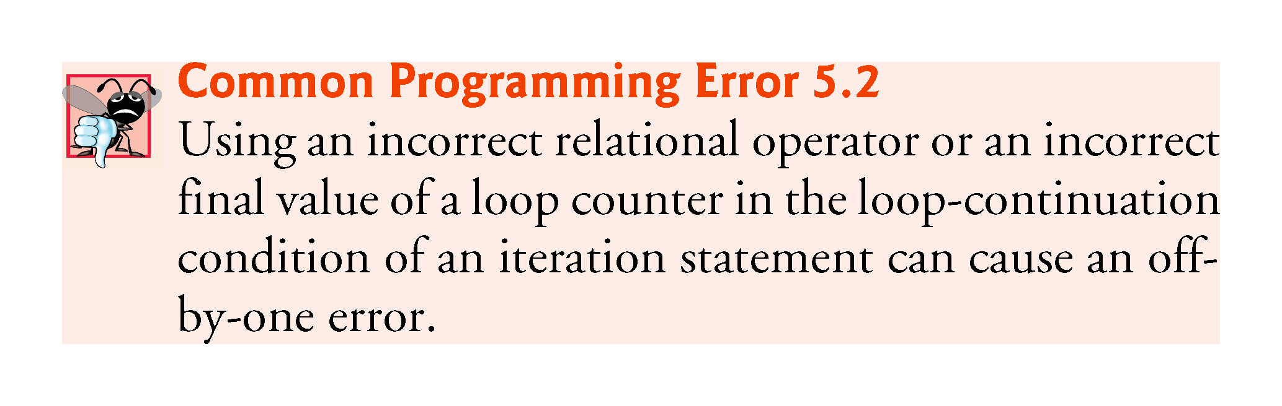

Slide 18
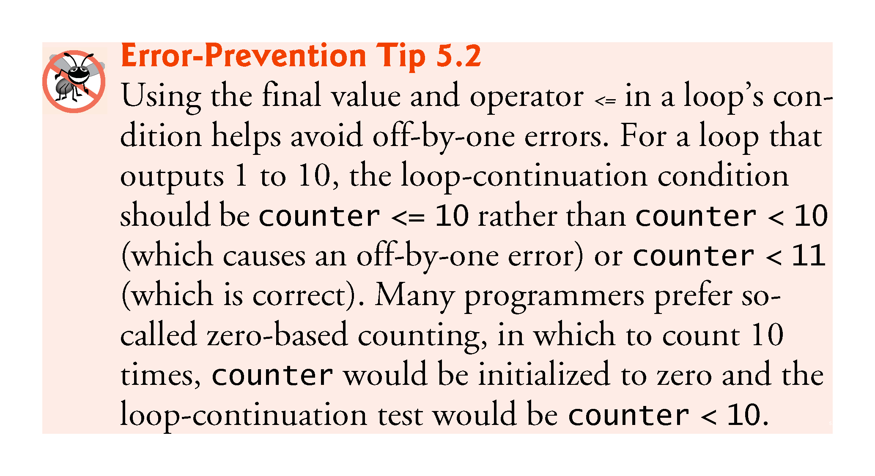

Slide 19
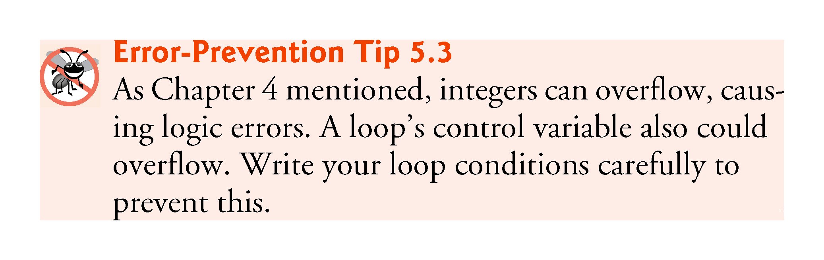

Slide 20
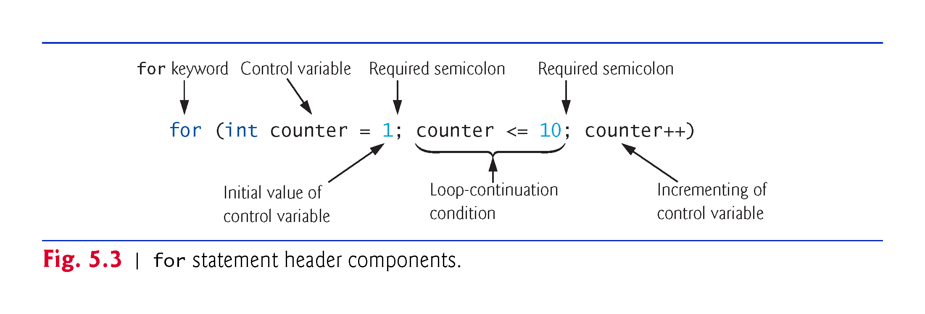

Slide 21
5.3 for Iteration Statement (Cont.)
The general format of the for statement is
for (initialization; loopContinuationCondition; increment) { statement }
the initialization expression names the loop’s control variable and optionally provides its initial value
loopContinuationCondition determines whether the loop should continue executing
increment modifies the control variable’s value, so that the loop-continuation condition eventually becomes false.
The two semicolons in the for header are required.

Slide 22
5.3 for Iteration Statement (Cont.)
The for statement often can be represented with an equivalent while statement as follows:
initialization;
while (loopContinuationCondition) { statement increment; }
Typically, for statements are used for counter-controlled iteration and while statements for sentinel-controlled iteration.
If the initialization expression in the for header declares the control variable, the control variable can be used only in that for statement.

Slide 23
5.3 for Iteration Statement (Cont.)
A variable’s scope defines where it can be used in a program.
A local variable can be used only in the method that declares it and only from the point of declaration through the end of the method.

Slide 24
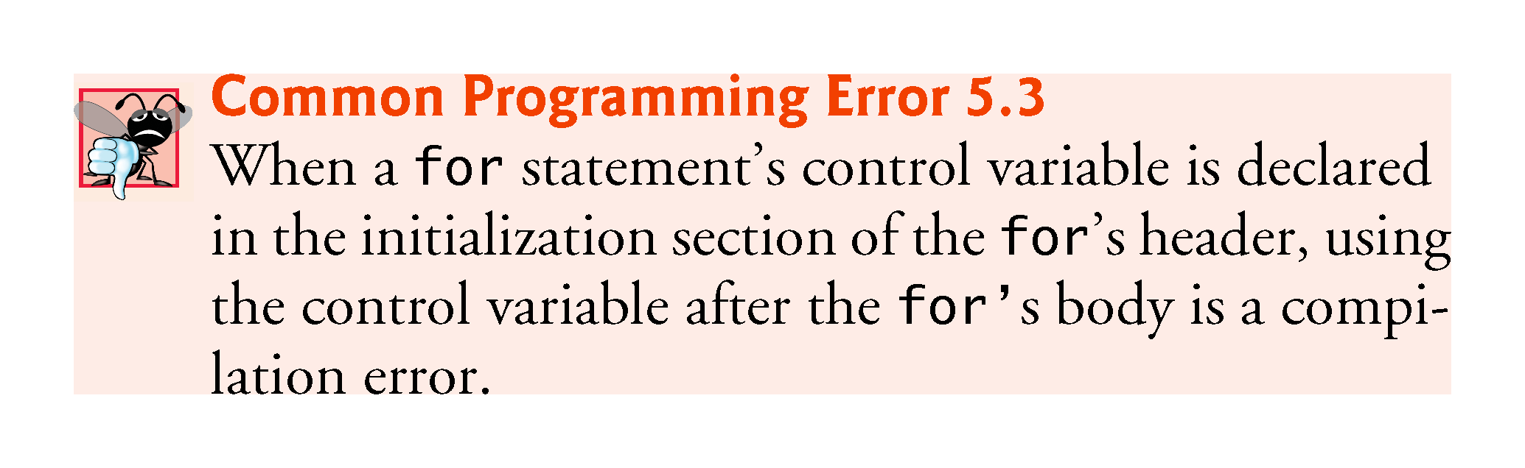

Slide 25
5.3 for Iteration Statement (Cont.)
All three expressions in a for header are optional.
If the loopContinuationCondition is omitted, the condition is always true, thus creating an infinite loop.
You might omit the initialization expression if the program initializes the control variable before the loop.
You might omit the increment if the program calculates it with statements in the loop’s body or if no increment is needed.
The increment expression in a for acts as if it were a standalone statement at the end of the for’s body, so
counter = counter + 1 counter += 1 ++counter counter++
are equivalent increment expressions in a for statement.

Slide 26
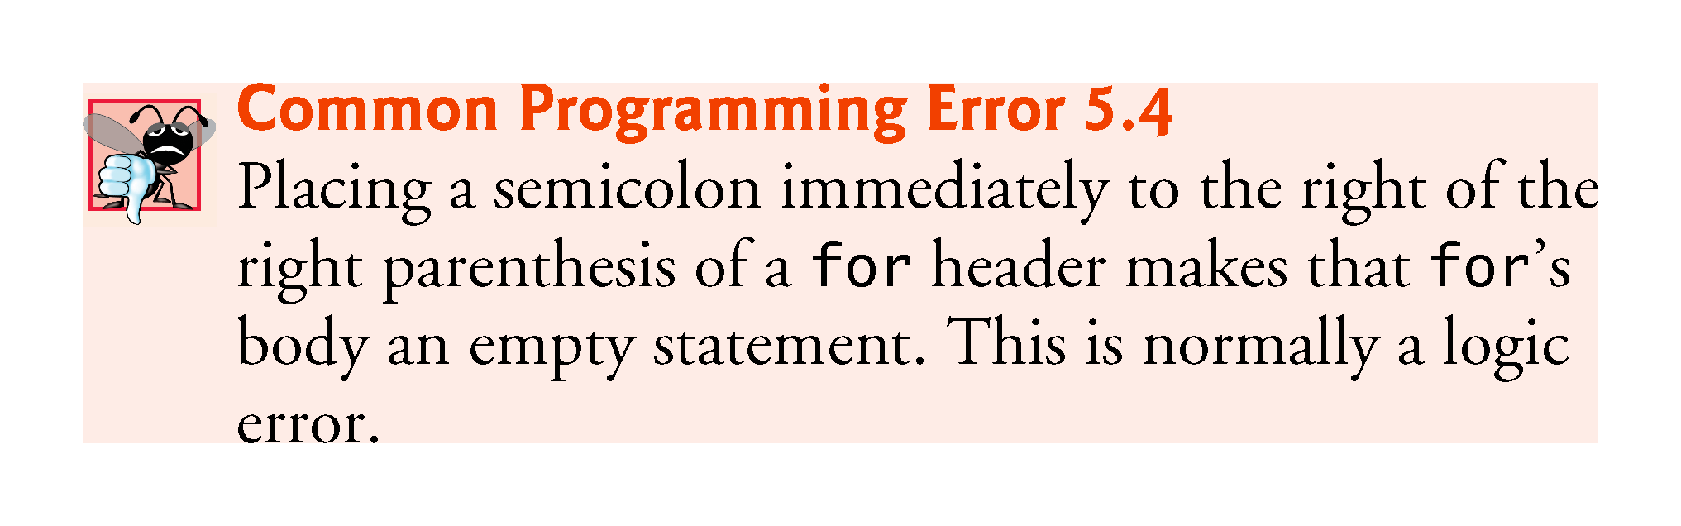

Slide 27
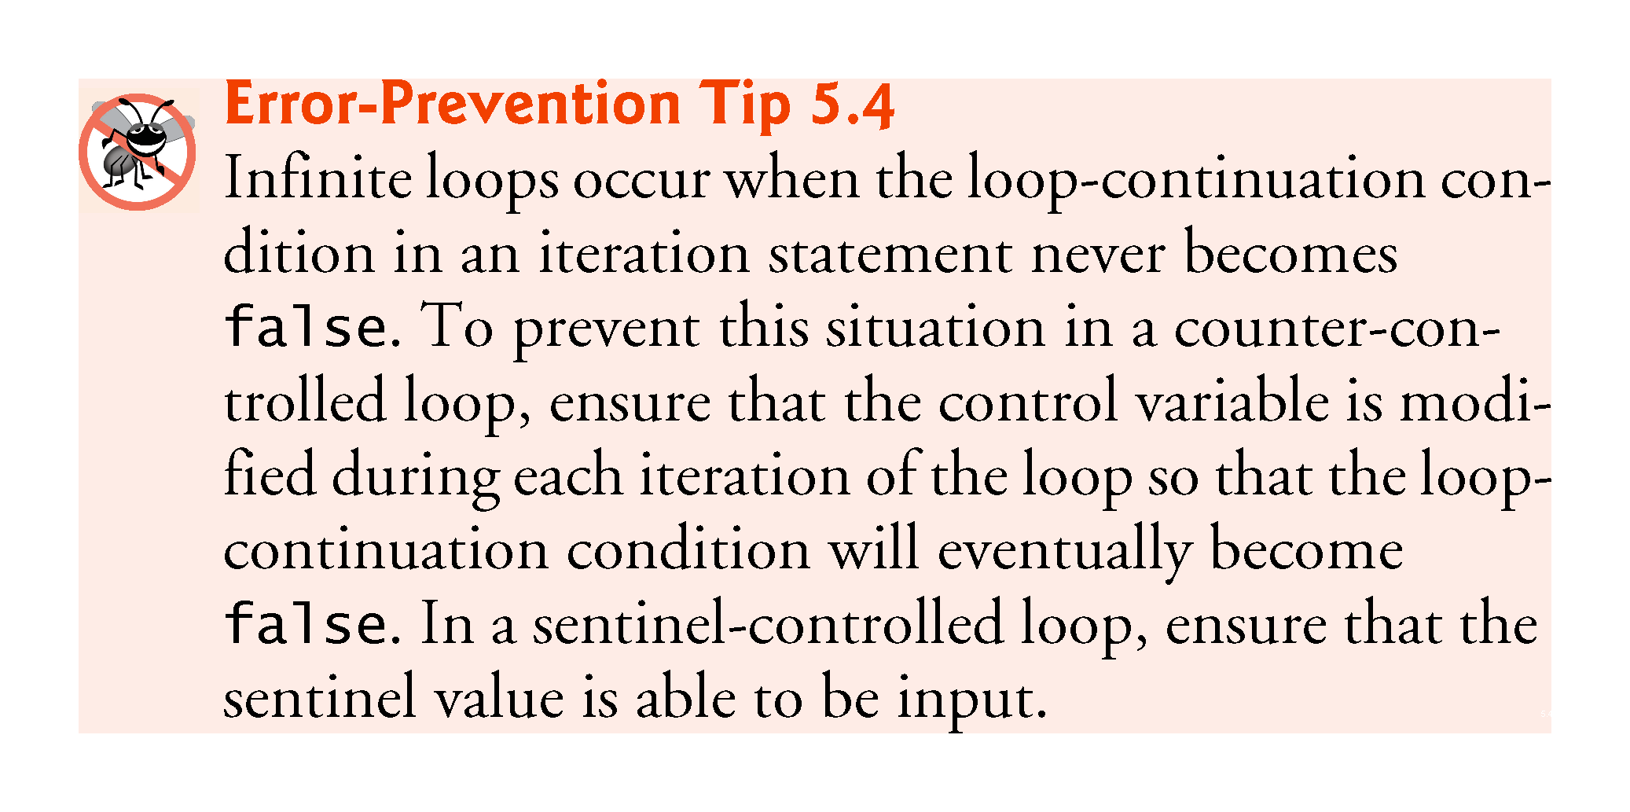

Slide 28
5.3 for Iteration Statement (Cont.)
The initialization, loop-continuation condition and increment can contain arithmetic expressions.
For example, assume that x = 2 and y = 10. If x and y are not modified in the body of the loop, the statement
for (int j = x; j <= 4 * x * y; j += y / x)
is equivalent to the statement
for (int j = 2; j <= 80; j += 5)
The increment of a for statement may be negative, in which case it’s a decrement, and the loop counts downward.

Slide 29
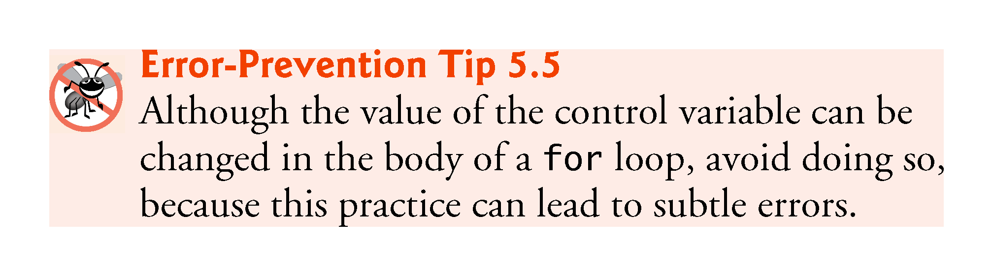

Slide 30
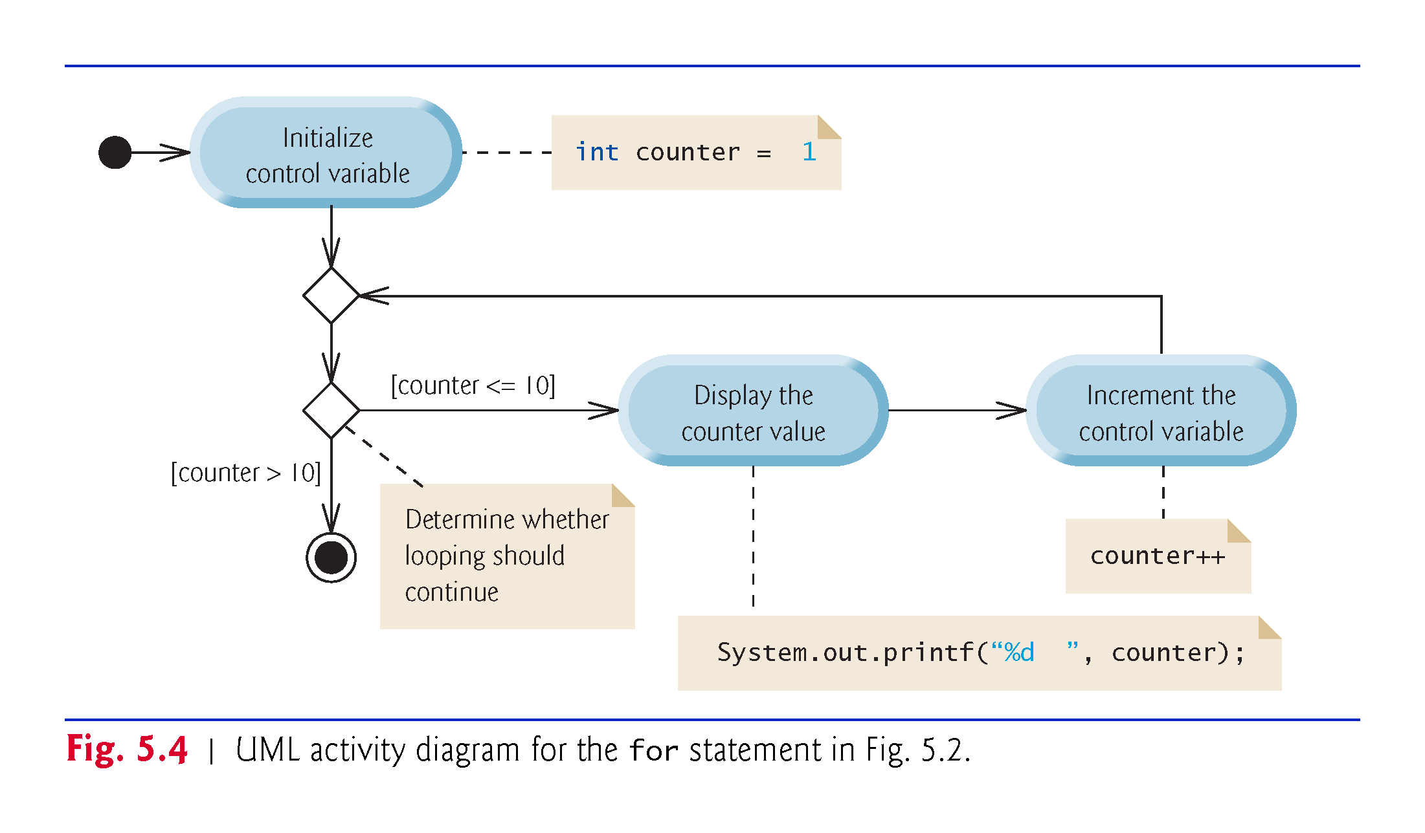

Slide 31
5.4 Examples Using the for Statement
a)Vary the control variable from 1 to 100 in increments of 1.
for (int i = 1; i <= 100; i++)
b)Vary the control variable from 100 to 1 in decrements of 1.
for (int i = 100; i >= 1; i--)
c)Vary the control variable from 7 to 77 in increments of 7.
for (int i = 7; i <= 77; i += 7)

Slide 32
5.4 Examples Using the for Statement (Cont.)
d)Vary the control variable from 20 to 2 in decrements of 2.
for (int i = 20; i >= 2; i -= 2)
e)Vary the control variable over the values 2, 5, 8, 11, 14, 17, 20.
for (int i = 2; i <= 20; i += 3)
f)Vary the control variable over the values 99, 88, 77, 66, 55, 44, 33, 22, 11, 0.
for (int i = 99; i >= 0; i -= 11)

Slide 33
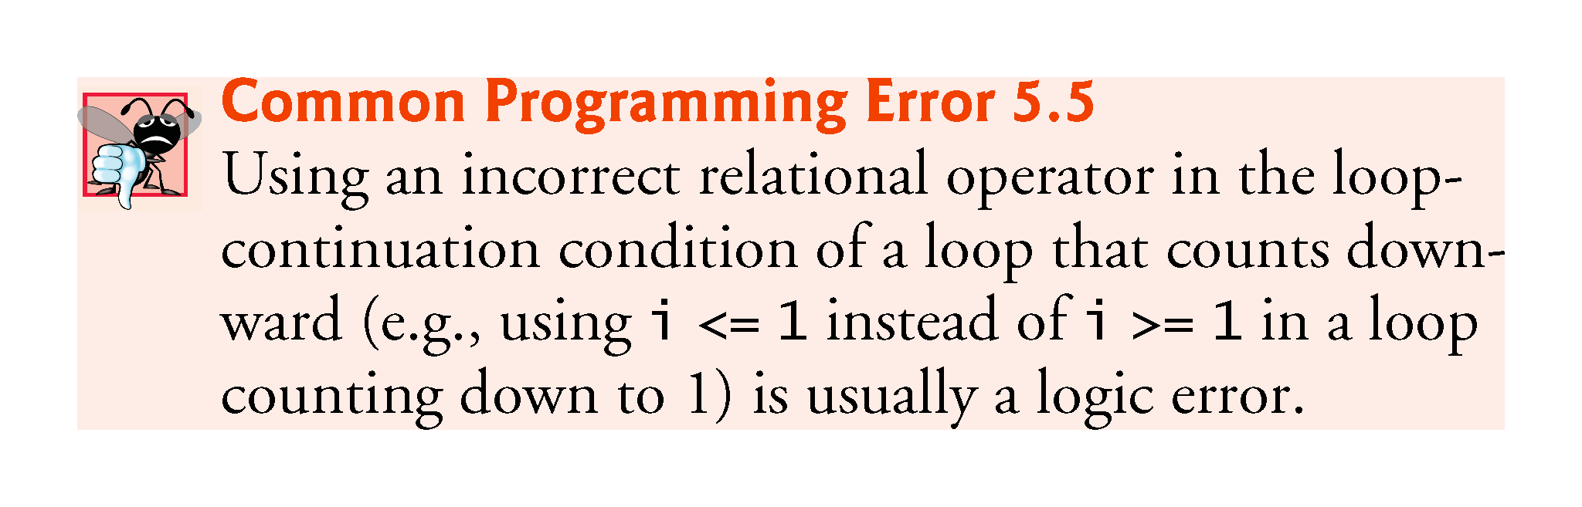

Slide 34
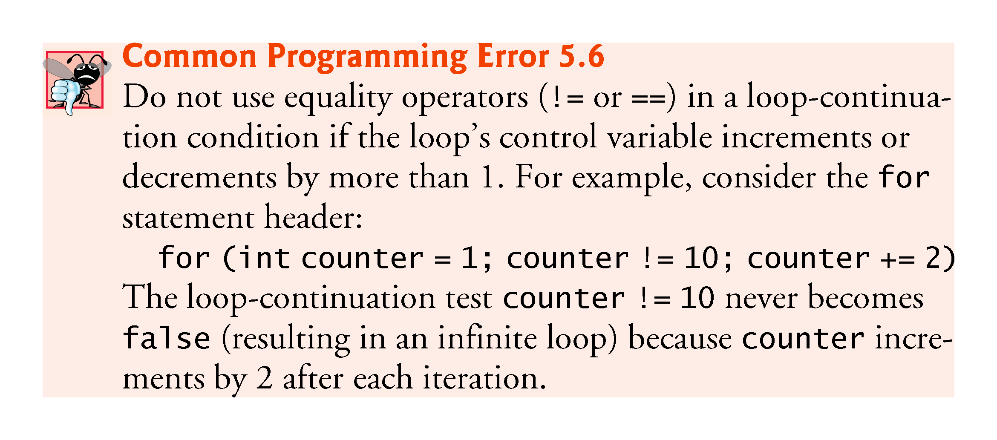

Slide 35
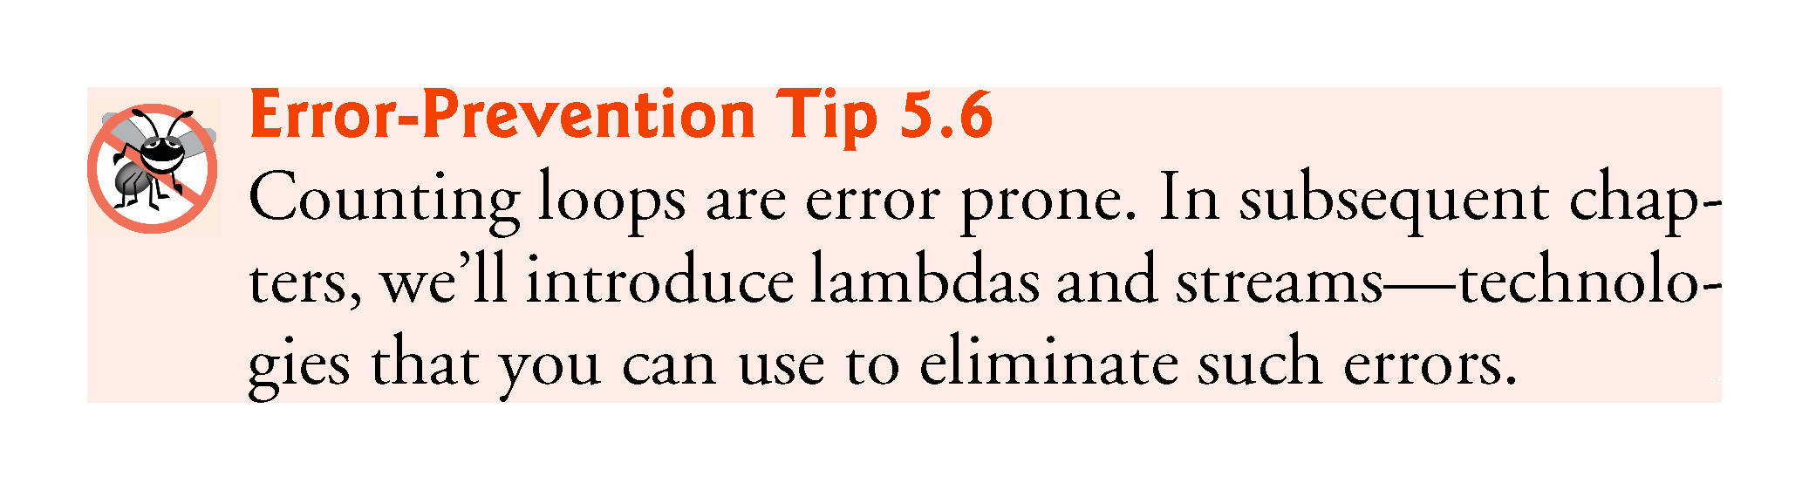

Slide 36
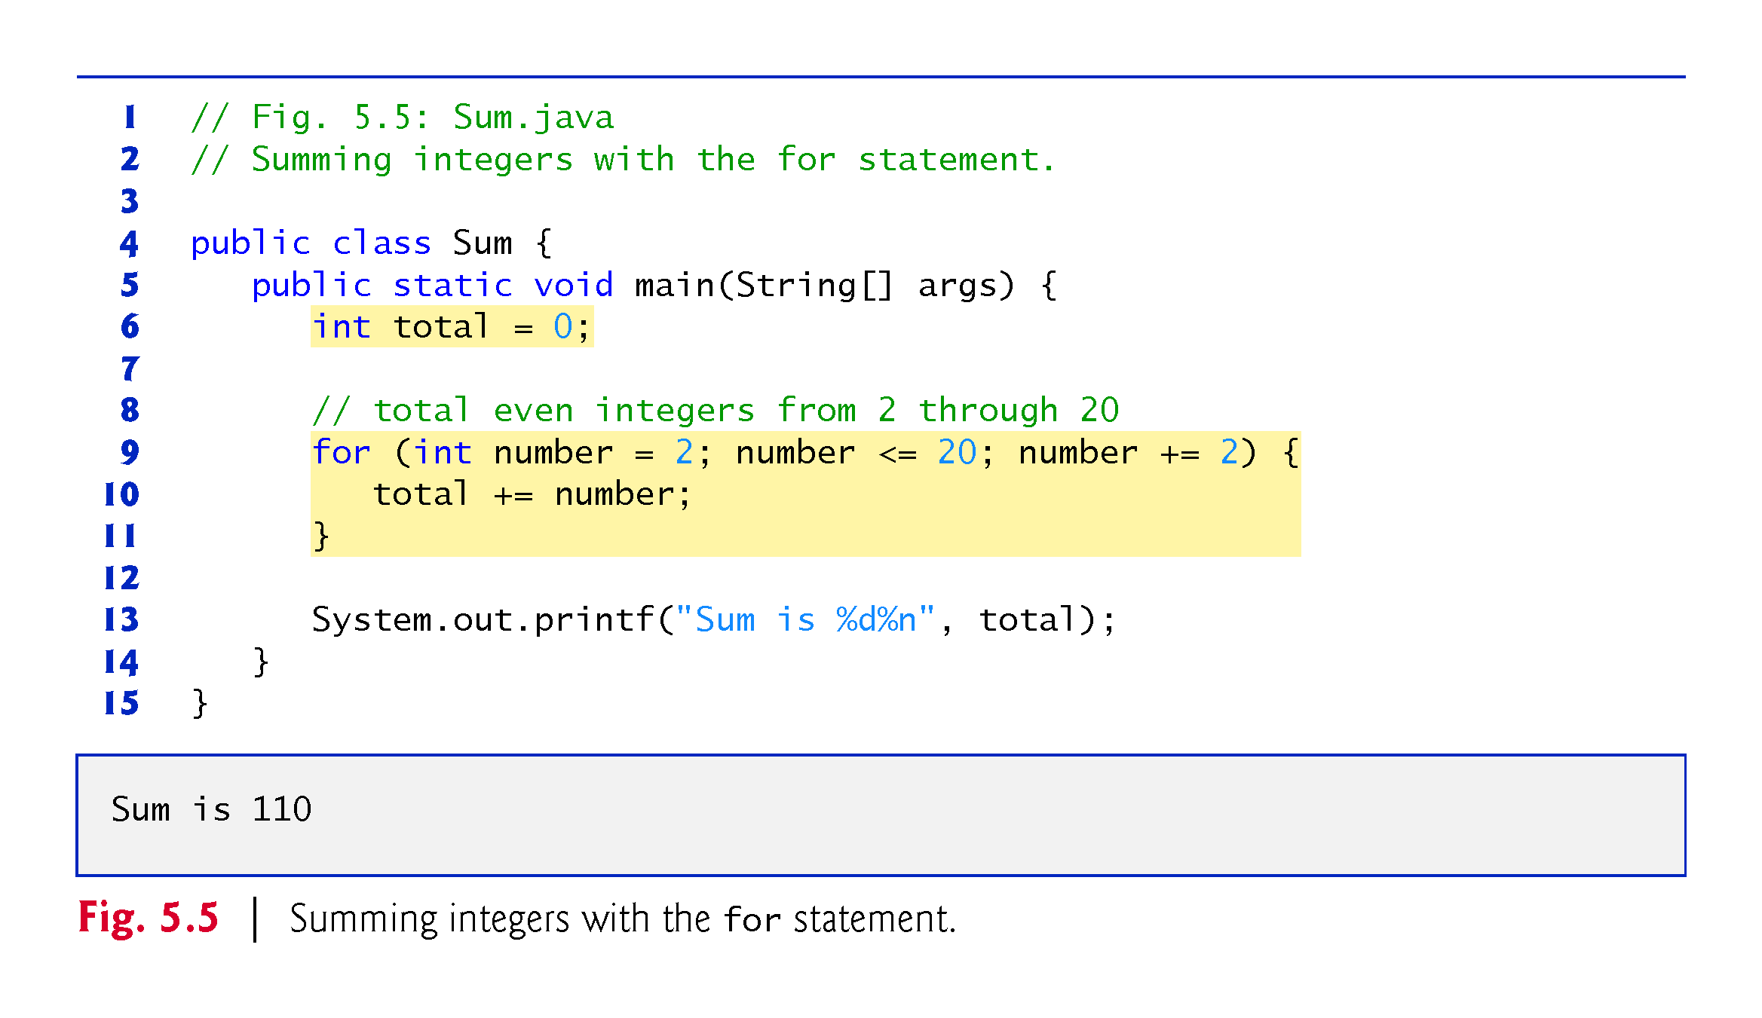

Slide 37
5.4 Examples Using the for Statement (Cont.)
The initialization and increment expressions can be comma-separated lists that enable you to use multiple initialization expressions or multiple increment expressions.
Although this is discouraged, the body of the for statement of Fig. 5.5 could be merged into the increment portion of the for header by using a comma as follows:
for (int number = 2; number <= 20; total += number, number += 2) { ; // empty statement }

Slide 38
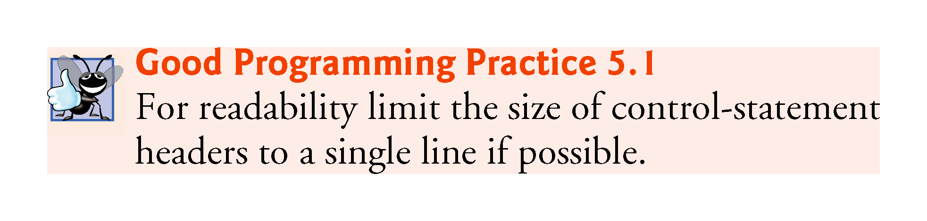

Slide 39
5.4 Examples Using the for Statement (Cont.)
Compound interest application
A person invests $1,000 in a savings account yielding 5% interest. Assuming that all the interest is left on deposit, calculate and print the amount of money in the account at the end of each year for 10 years. Use the following formula to determine the amounts:
a = p (1 + r)^{n}
where
p is the original amount invested (i.e., the principal) r is the annual interest rate (e.g., use 0.05 for 5%) n is the number of years a is the amount on deposit at the end of the nth year.

Slide 40
5.4 Examples Using the for Statement (Cont.)
The solution to this problem (Fig. 5.6) involves a loop that performs the indicated calculation for each of the 10 years the money remains on deposit.
Java treats floating-point constants like 1000.0 and 0.05 as type double.
Java treats whole-number constants like 7 and -22 as type int.

Slide 41
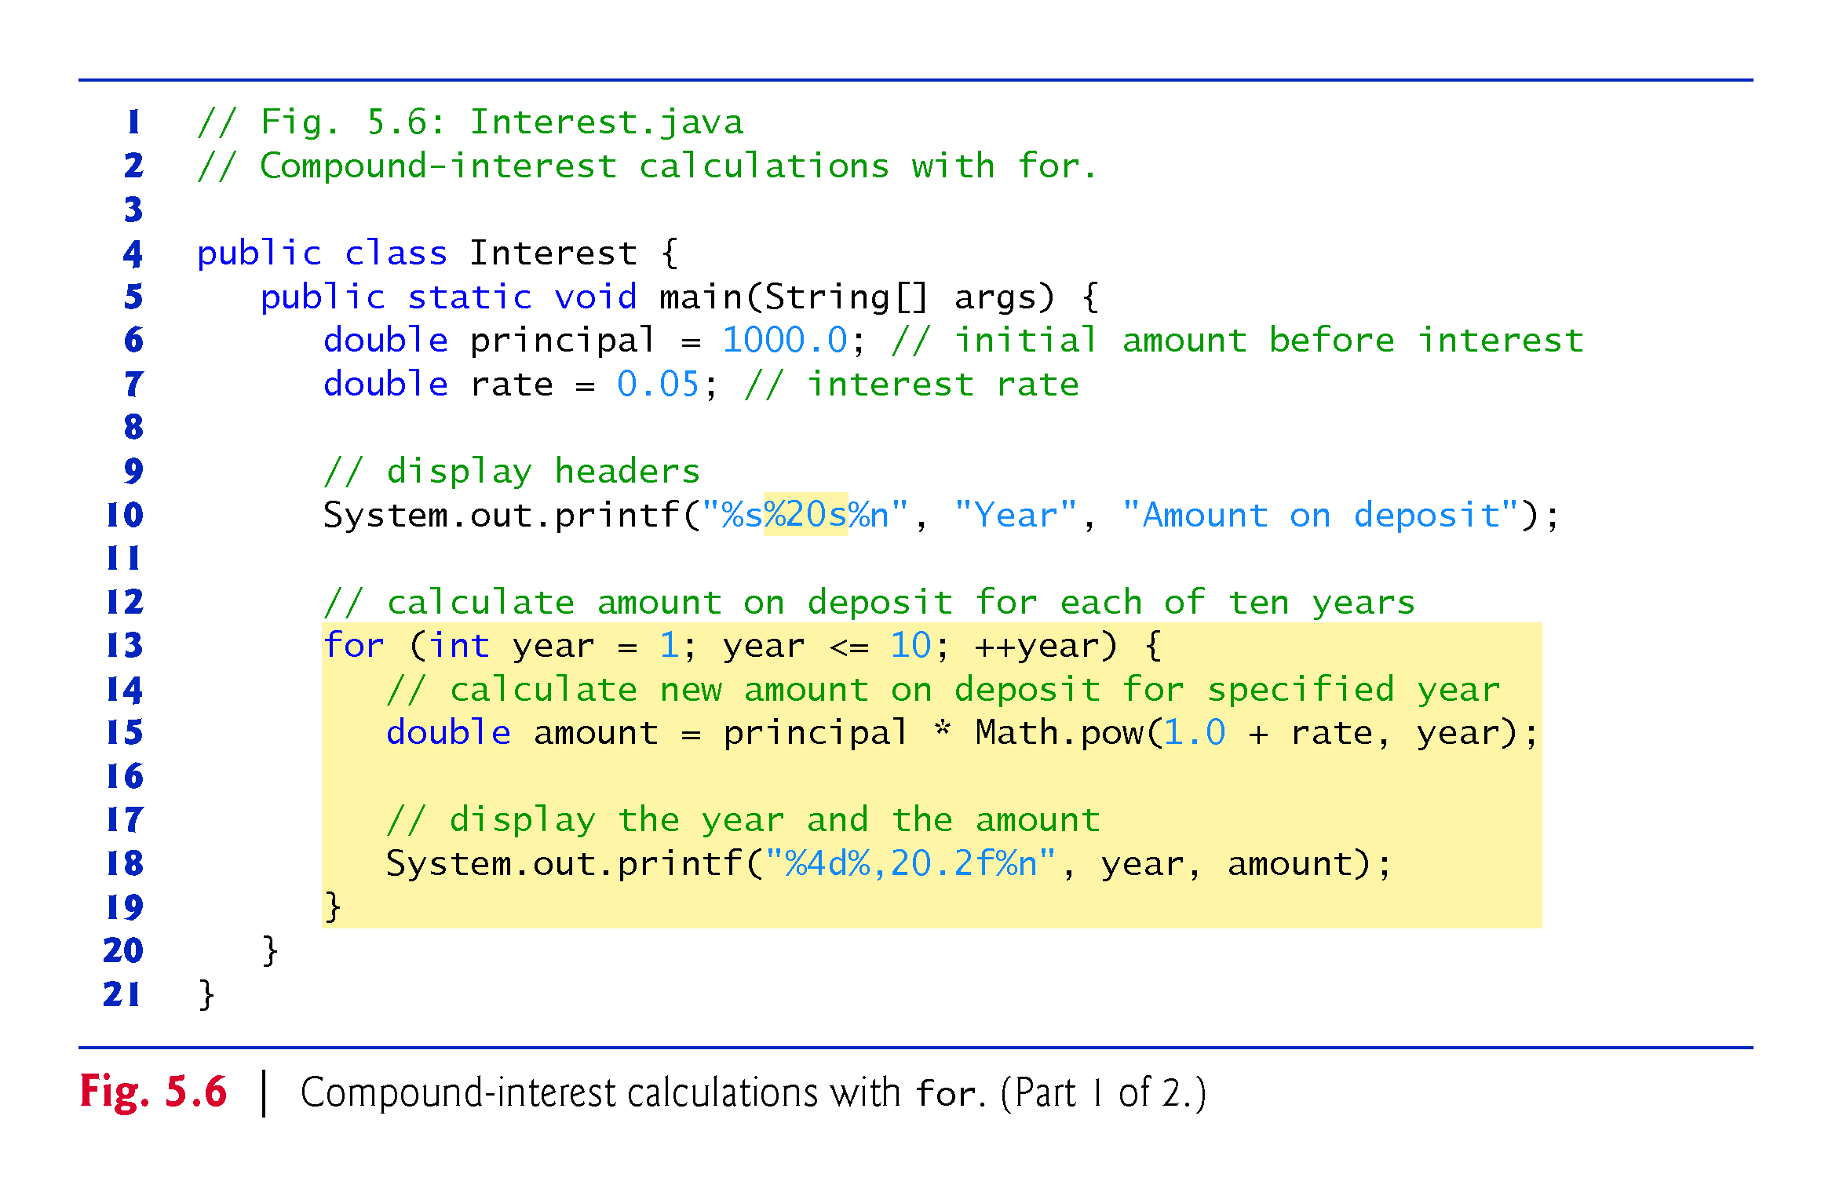

Slide 42
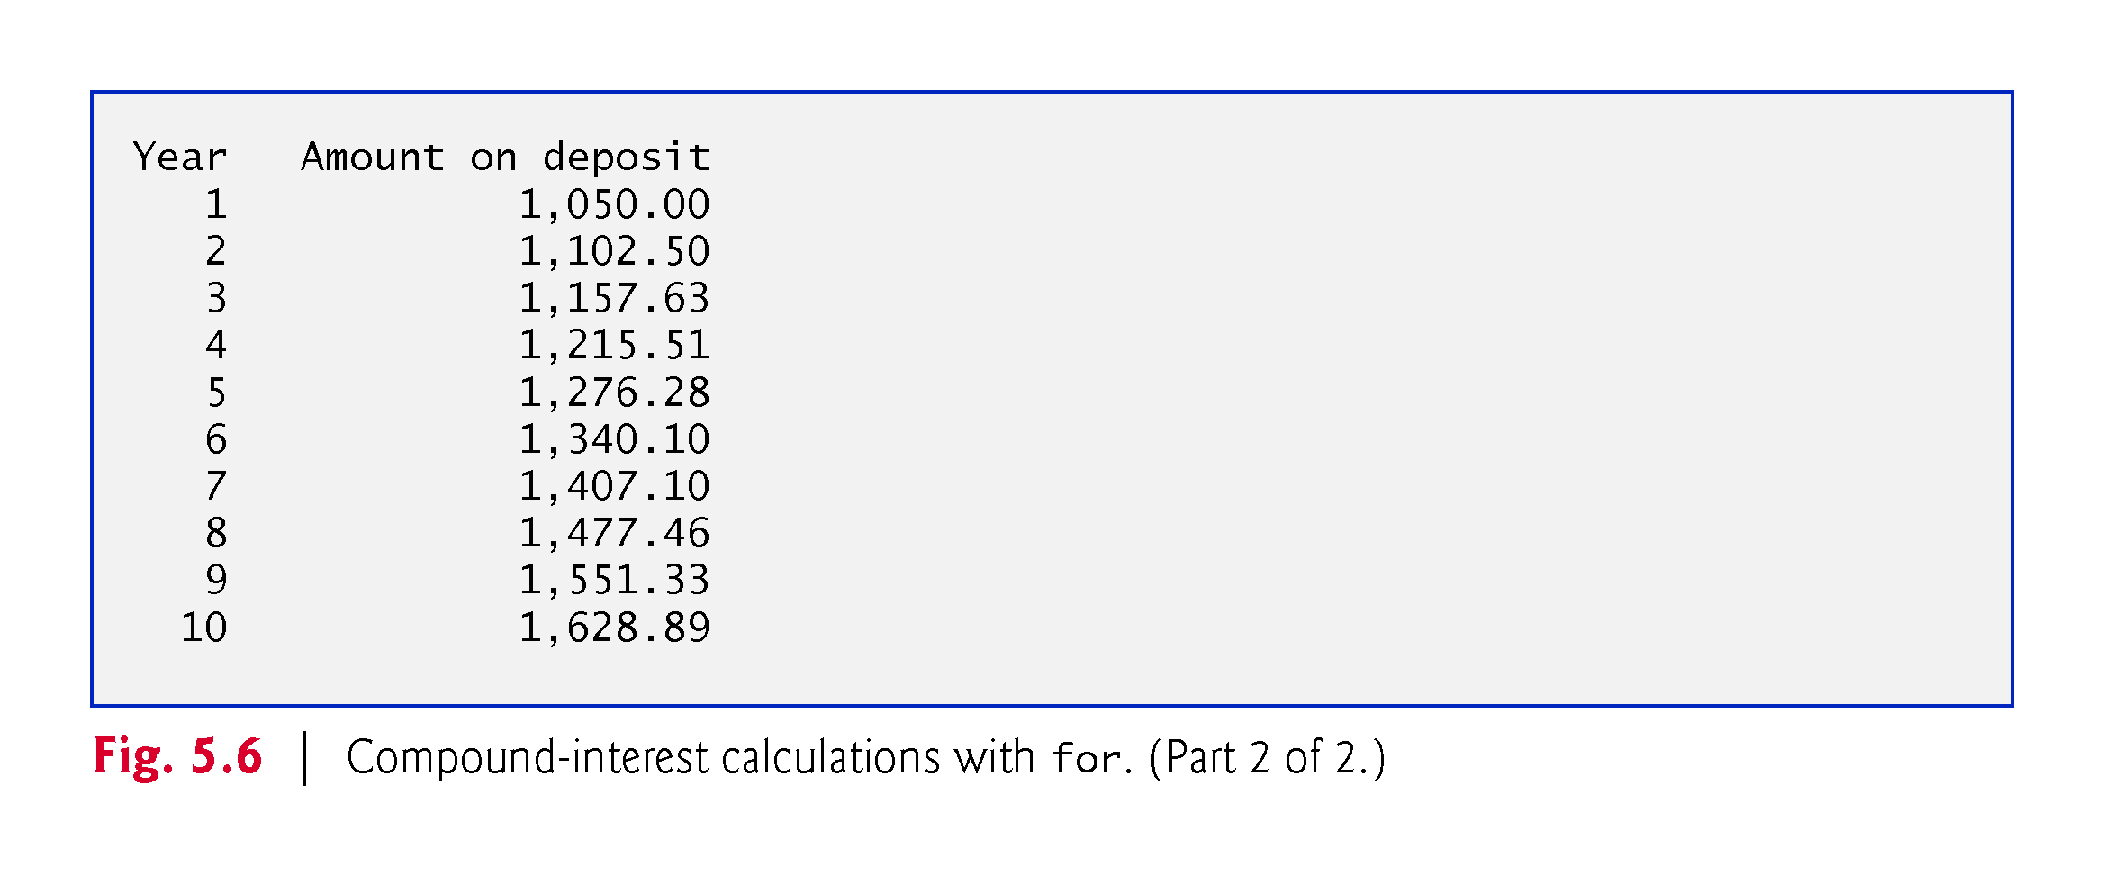

Slide 43
5.4 Examples Using the for Statement (Cont.)
In the format specifier %20s, the integer 20 between the % and the conversion character s indicates that the value output should be displayed with a field width of 20—that is, printf displays the value with at least 20 character positions.
If the value to be output is less than 20 character positions wide, the value is right justified in the field by default.
If the year value to be output were more thanhas more characters than the field width, the field width would be extended to the right to accommodate the entire value.
To indicate that values should be output left justified, precede the field width with the minus sign (–) formatting flag (e.g., %-20s).

Slide 44
5.4 Examples Using the for Statement (Cont.)
Classes provide methods that perform common tasks on objects.
Most methods must be called on a specific object.
Someclasses also provide methods that perform common tasks and do not require you to first create objects of those classes. These are called static methods.
Java does not include an exponentiation operator—Math class static method pow can be used for raising a value to a power.
You can call a static method by specifying the class name followed by a dot (.) and the method name, as in
ClassName.methodName(arguments)
Math.pow(x, y) calculates the value of x raised to the y^{th} power. The method receives two double arguments and returns a double value.

Slide 45
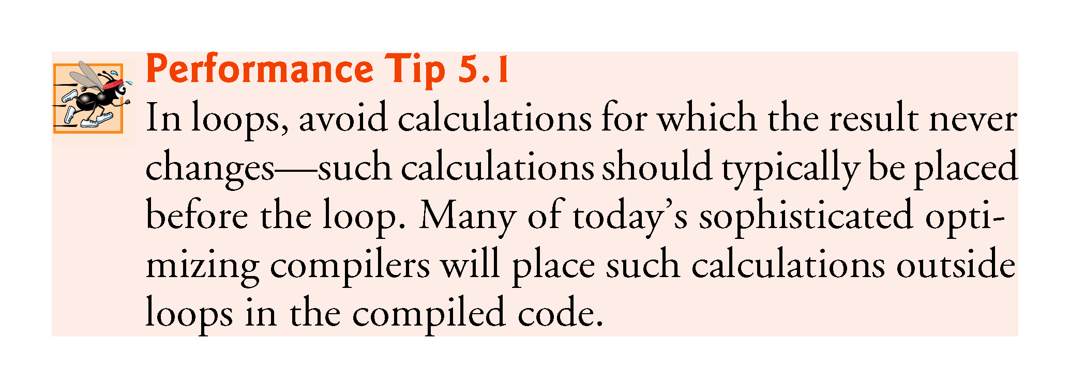

Slide 46
5.4 Examples Using the for Statement (Cont.)
In the format specifier %,20.2f, the comma (,) formatting flag indicates that the floating-point value should be output with a grouping separator.
Separator is specific to the user’s locale (i.e., country).
In the United States, the number will be output using commas to separate every three digits and a decimal point to separate the fractional part of the number, as in 1,234.45.
The number 20 in the format specification indicates that the value should be output right justified in a field width of 20 characters.
The .2 specifies the formatted number’s precision—in this case, the number is rounded to the nearest hundredth and output with two digits to the right of the decimal point.

Slide 47
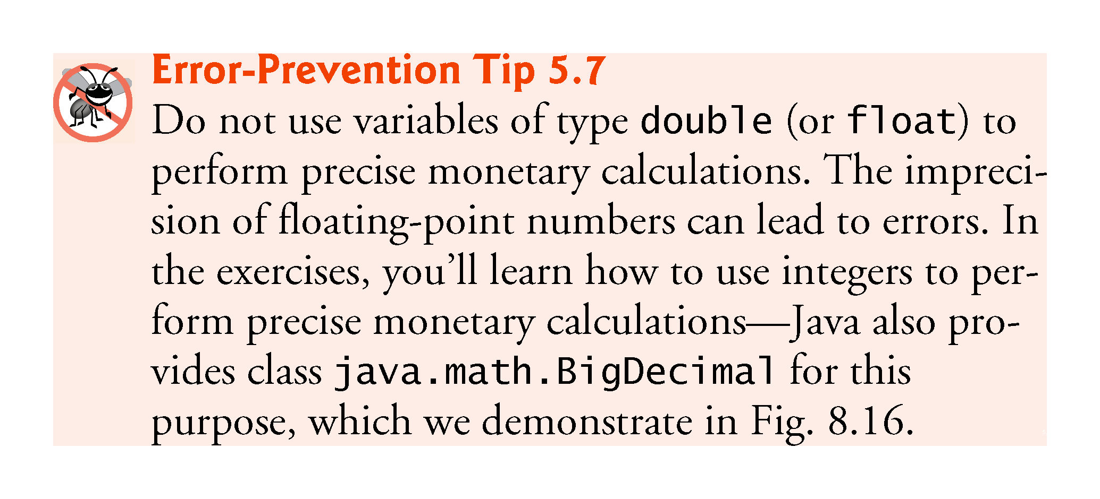

Slide 48
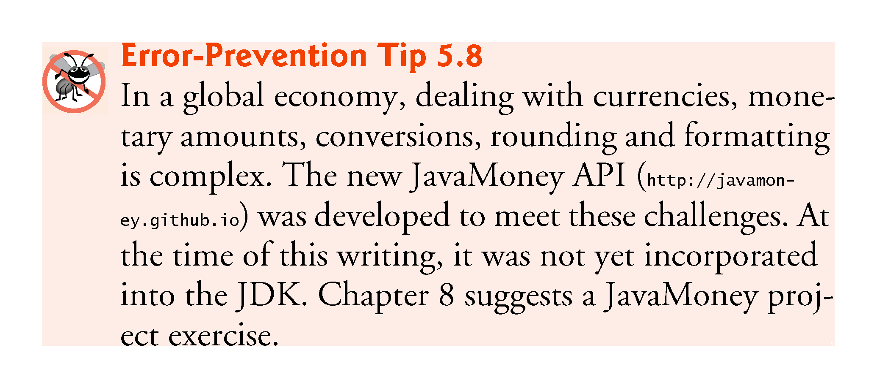

Slide 49
5.5 do…while Iteration Statement
The do…while iteration statement is similar to the while statement.
In the while, the program tests the loop-continuation condition at the beginning of the loop, before executing the loop’s body; if the condition is false, the body never executes.
The do…while statement tests the loop-continuation condition after executing the loop’s body; therefore, the body always executes at least once.
When a do…while statement terminates, execution continues with the next statement in sequence.

Slide 50
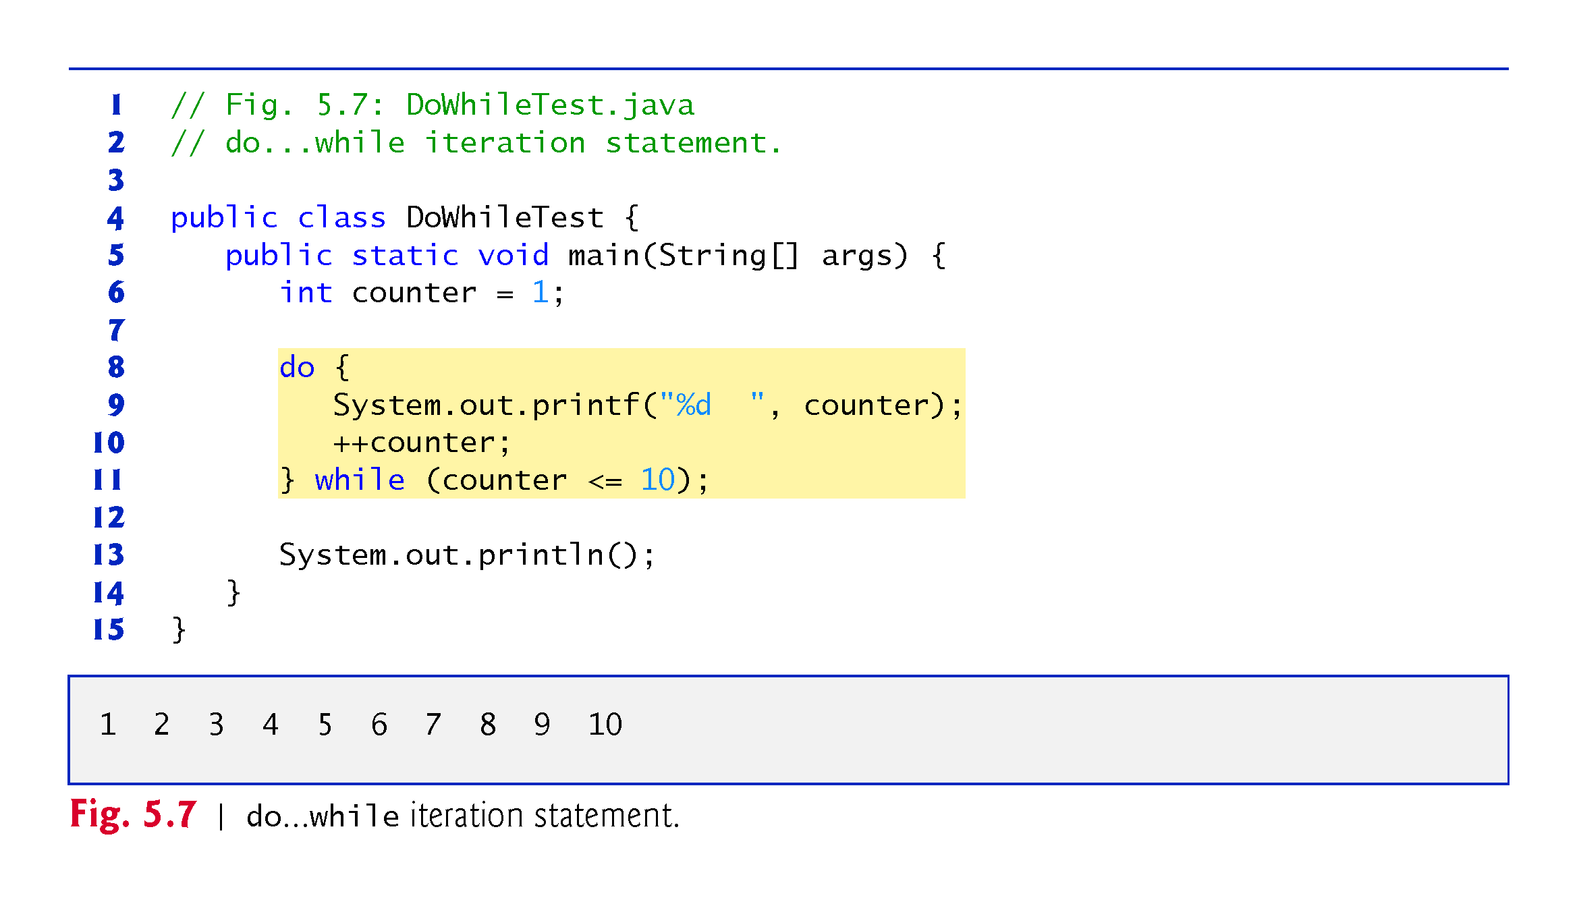

Slide 51
5.5 do…while Iteration Statement (Cont.)
Figure 5.8 contains the UML activity diagram for the do…while statement.
The diagram makes it clear that the loop-continuation condition is not evaluated until after the loop performs the action state at least once.

Slide 52
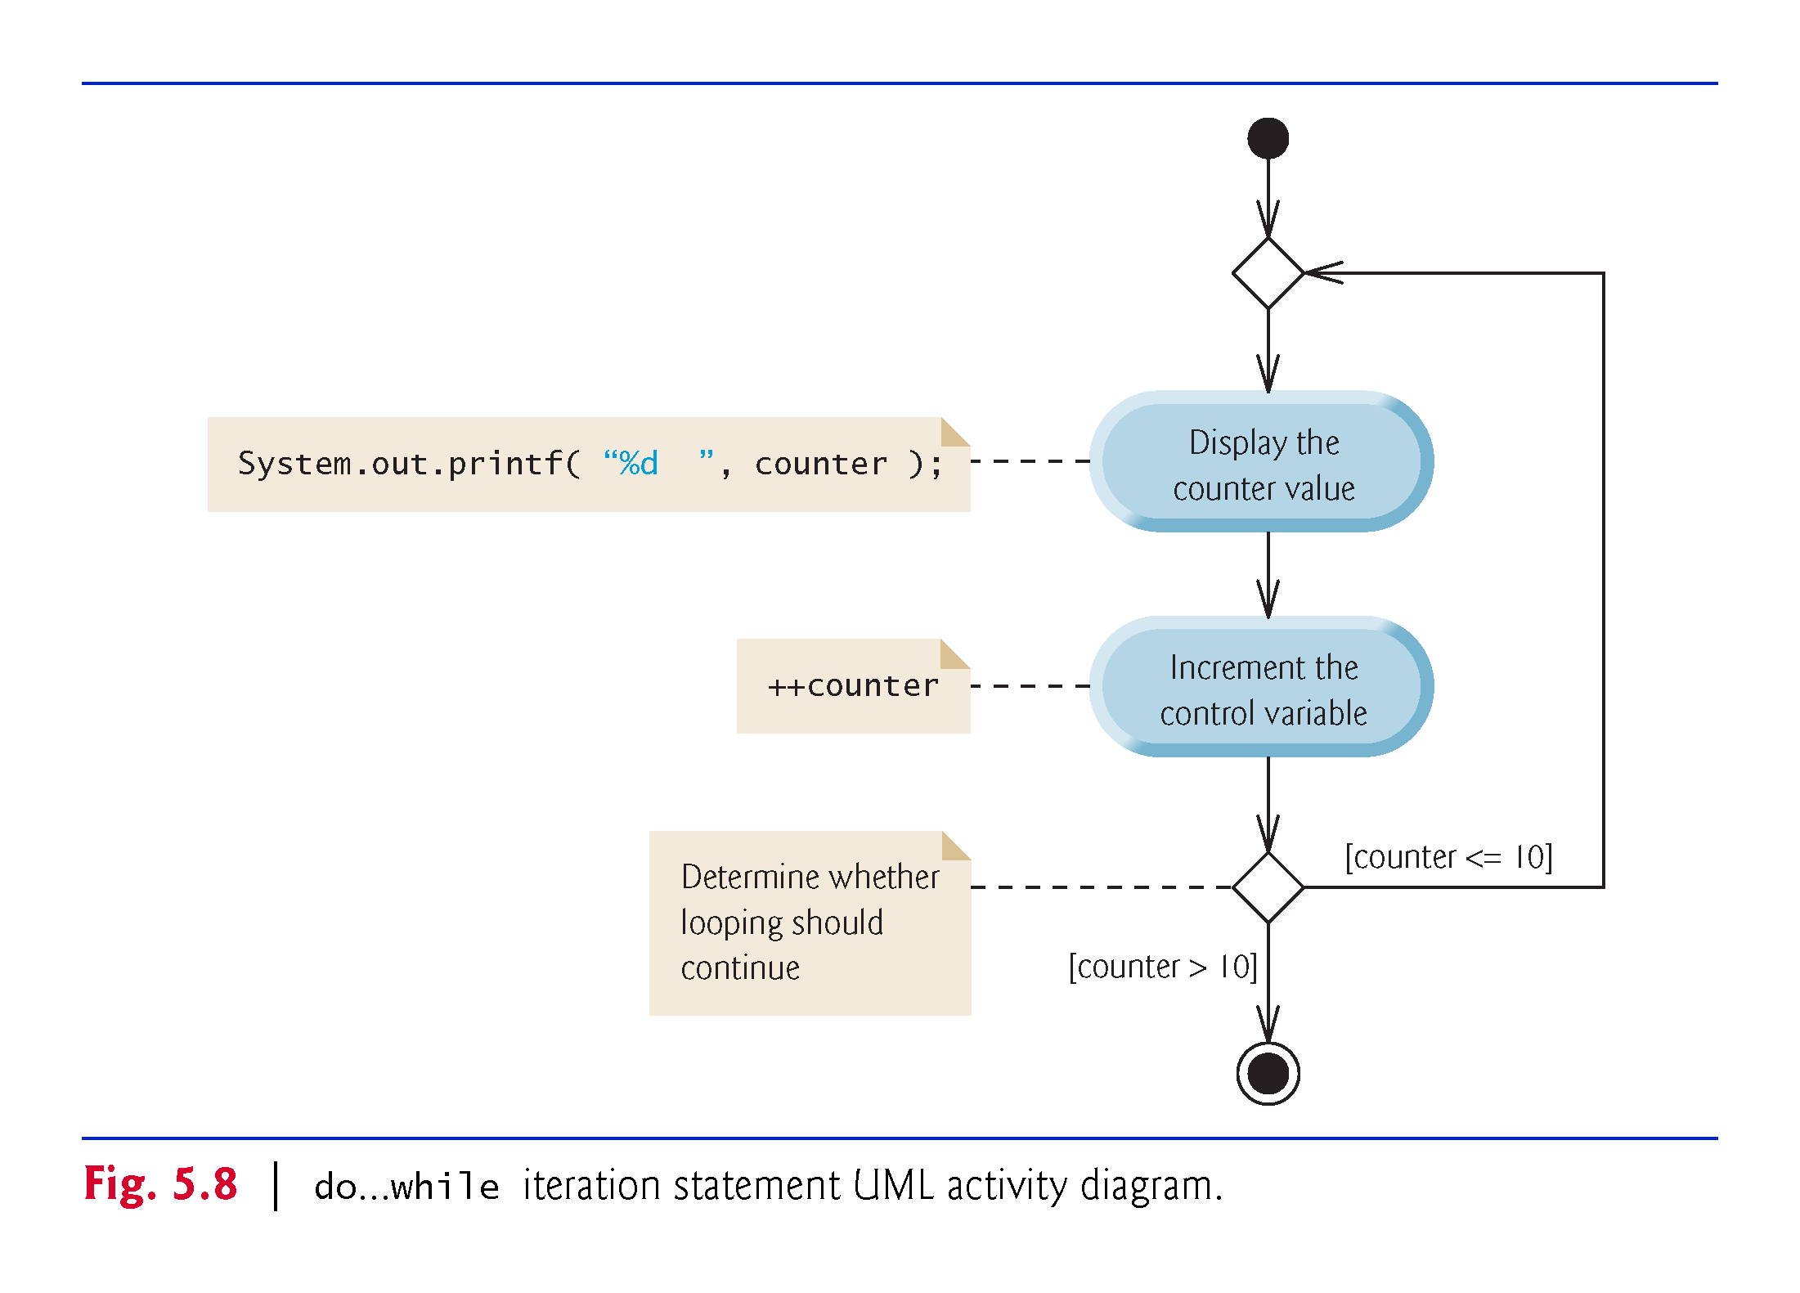

Slide 53
5.6 switch Multiple-Selection Statement
switch multiple-selection statement performs different actions based on the possible values of a constant integral expression of type byte, short, int or char.

Slide 54
5.6 switch Multiple-Selection Statement (Cont.)
The end-of-file indicator is a system-dependent keystroke combination which the user enters to indicate that there is no more data to input.
On UNIX/Linux/Mac OS X systems, end-of-file is entered by typing the sequence
<Ctrl> d
on a line by itself. This notation means to simultaneously press both the Ctrl key and the d key.
On Windows systems, end-of-file can be entered by typing
<Ctrl> z
On some systems, you must press Enter after typing the end-of-file key sequence.
Windows typically displays the characters ^Z on the screen when the end-of-file indicator is typed.

Slide 55
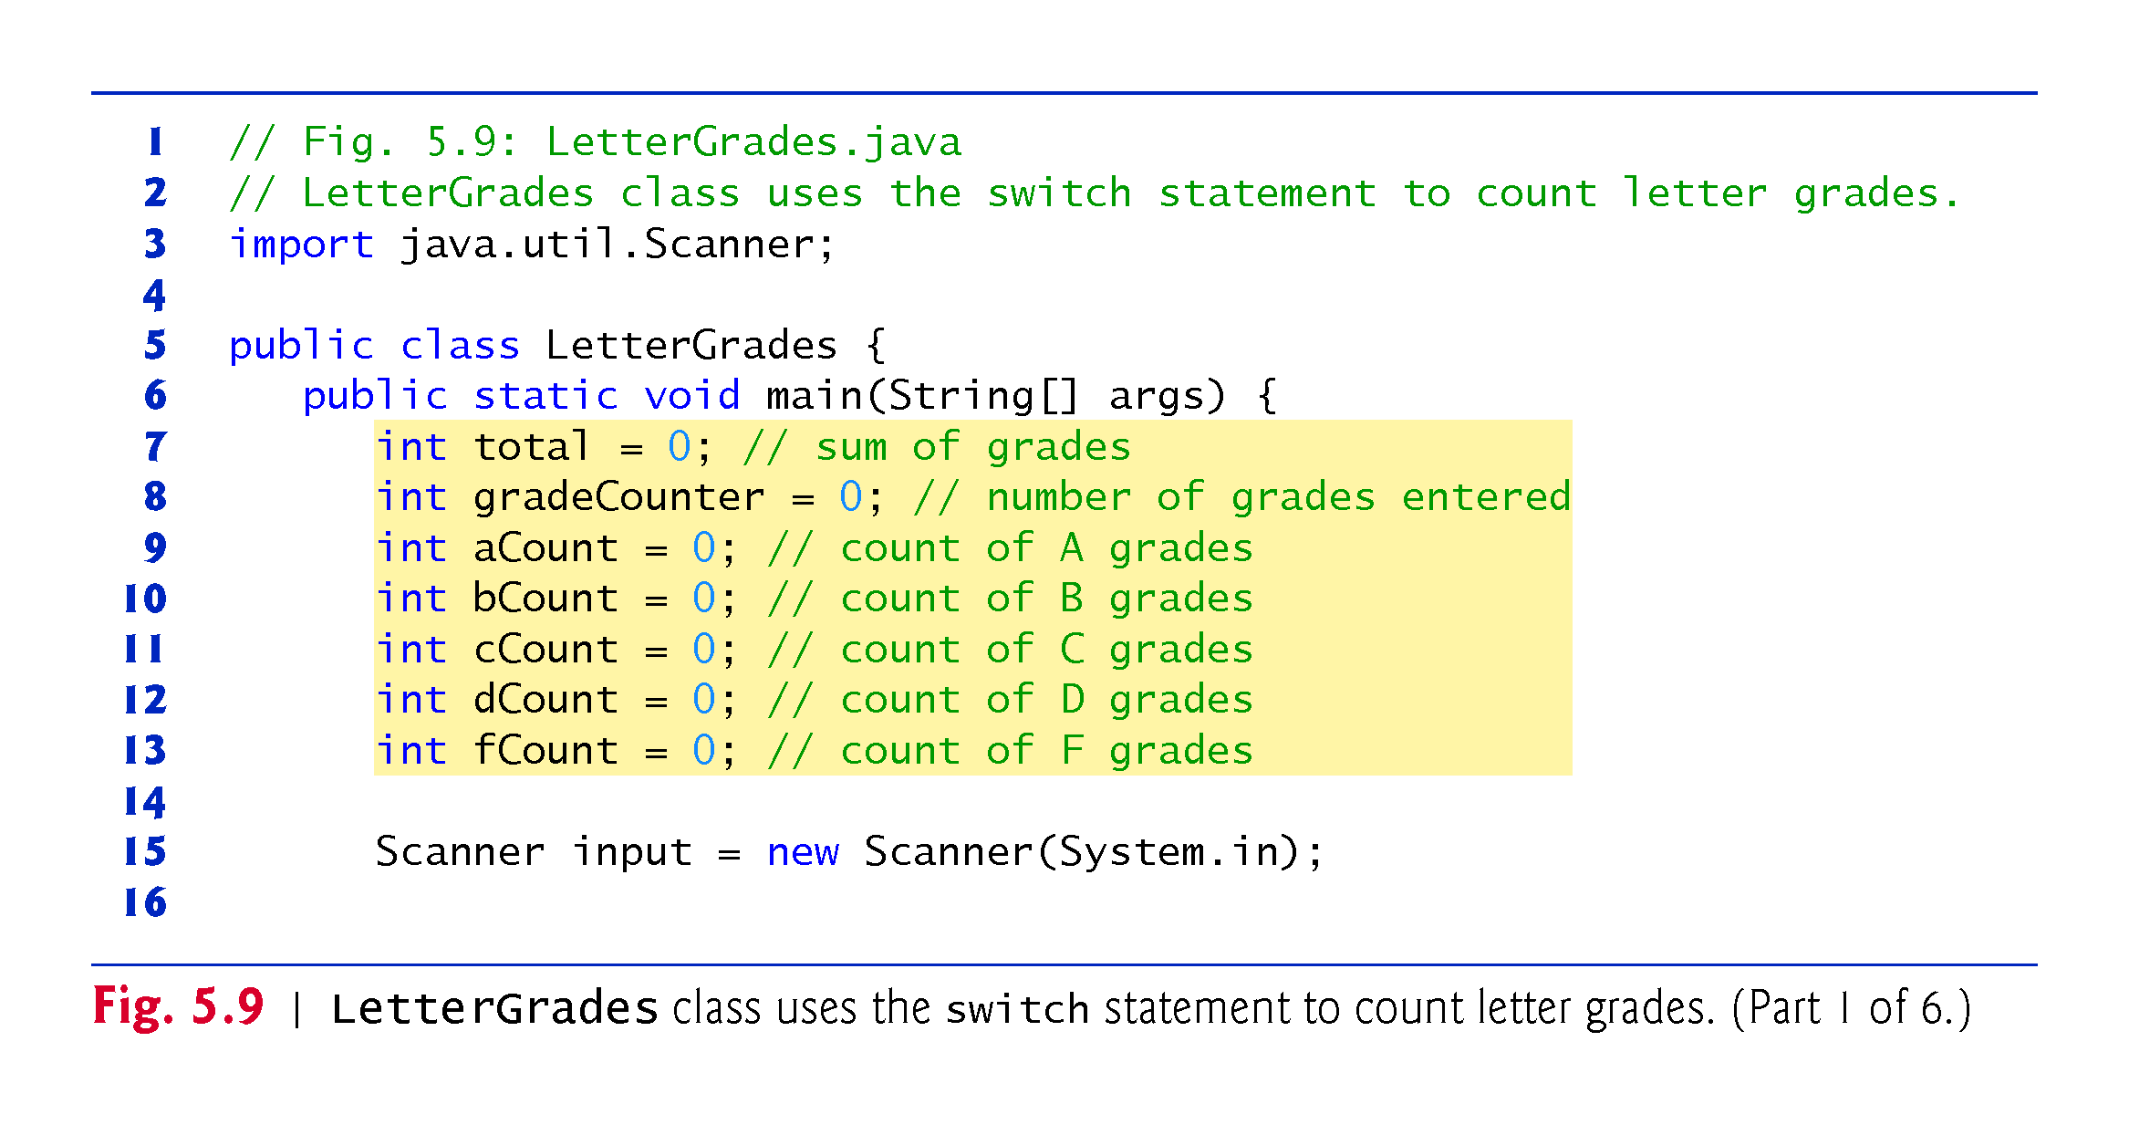

Slide 56
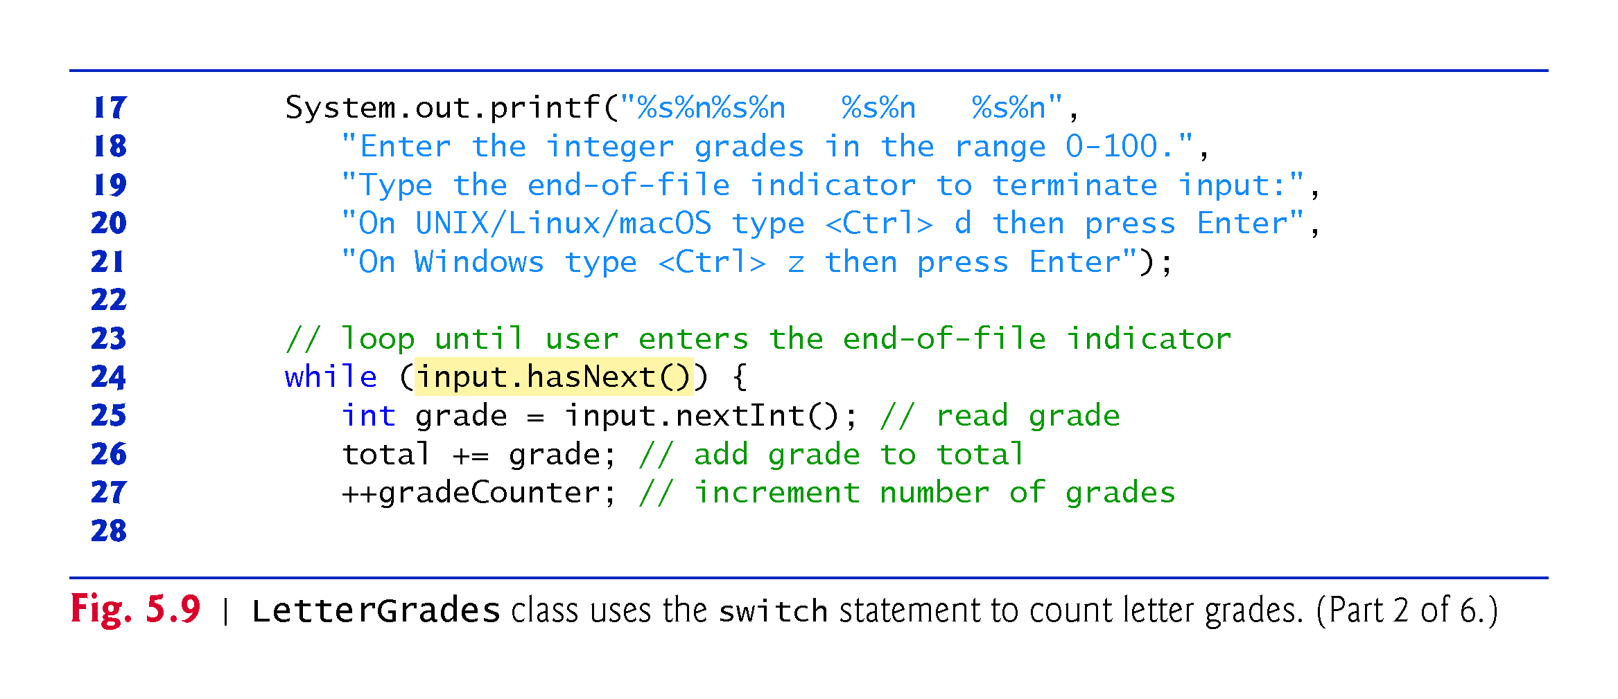

Slide 57
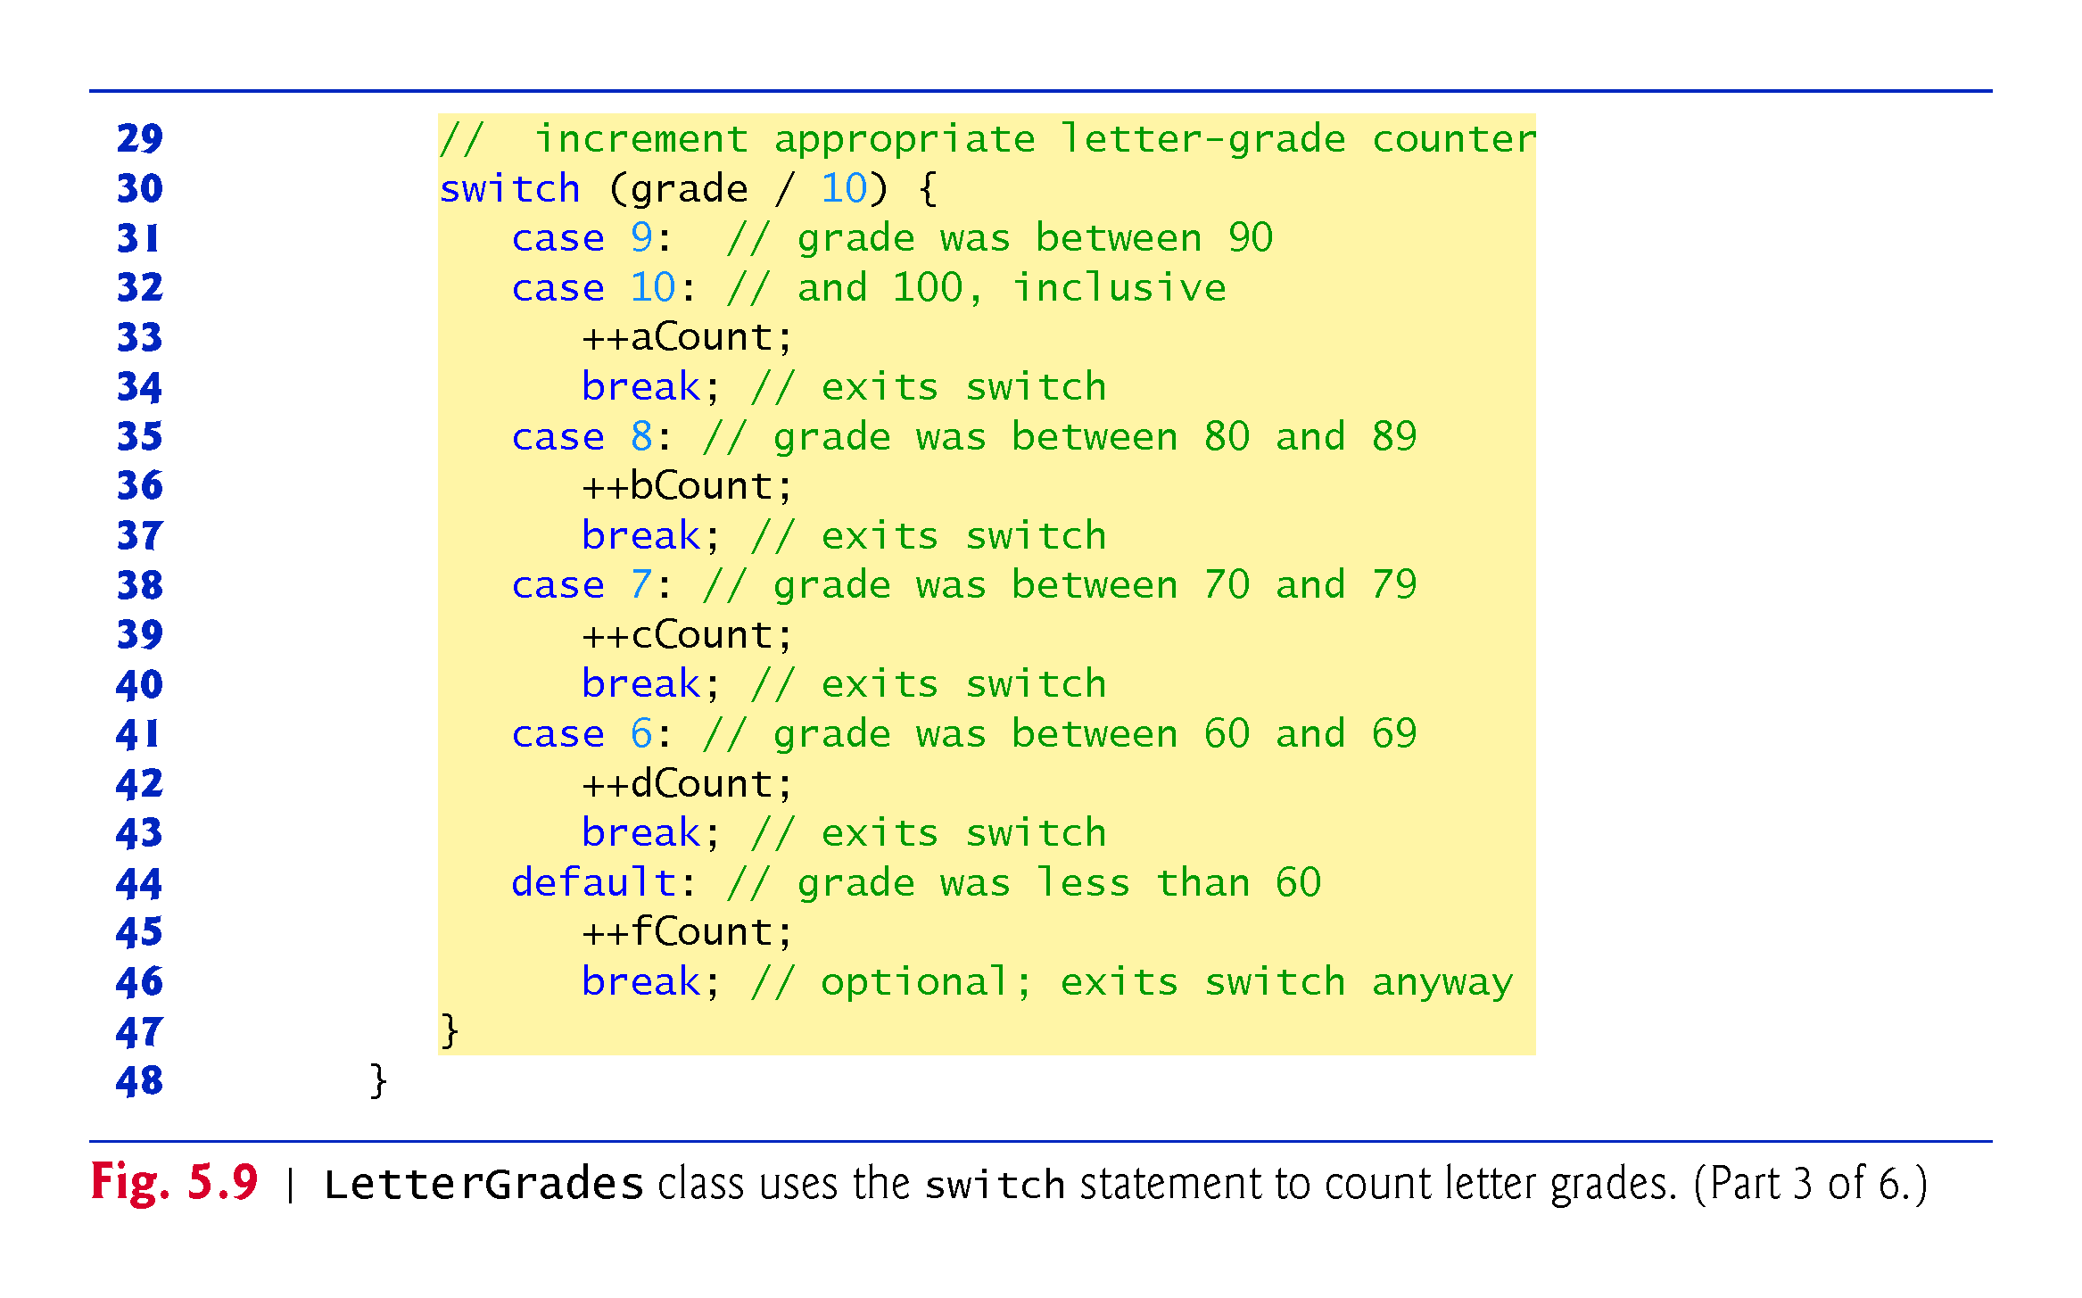

Slide 58
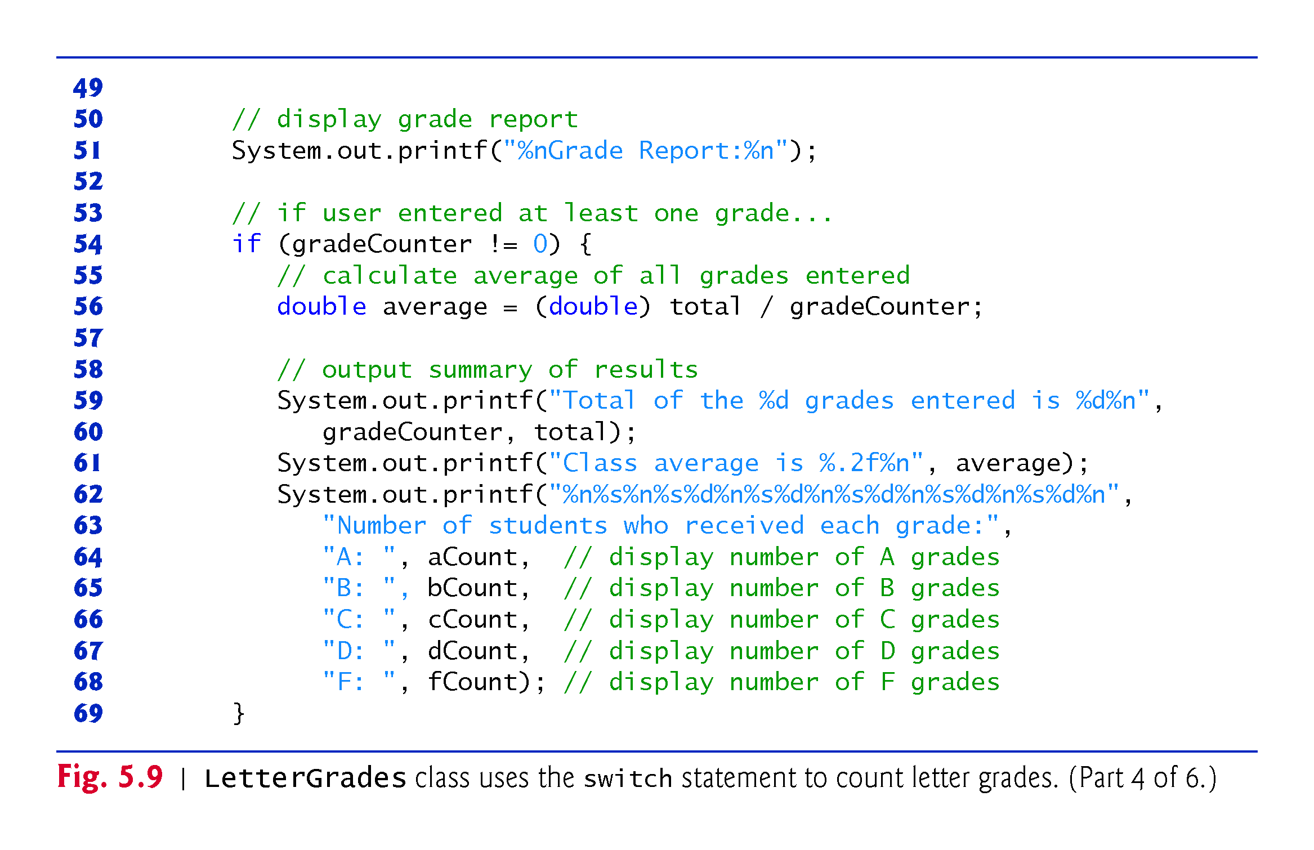

Slide 59
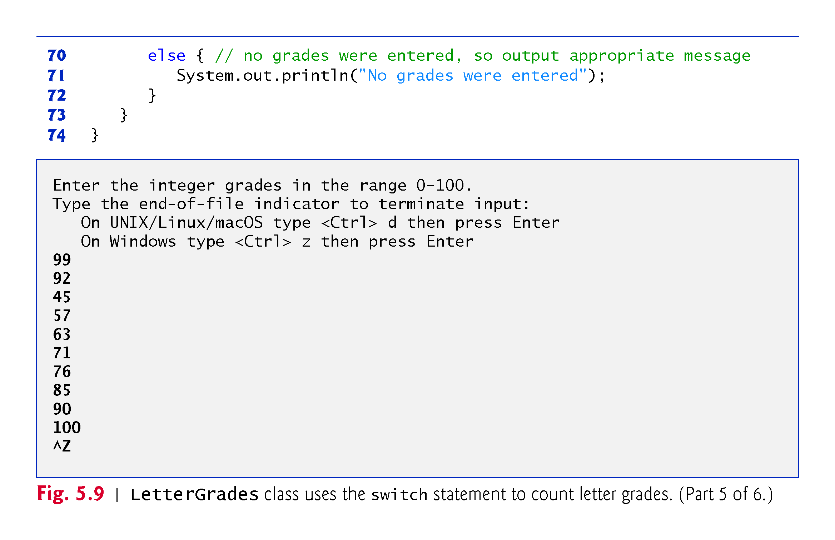

Slide 60
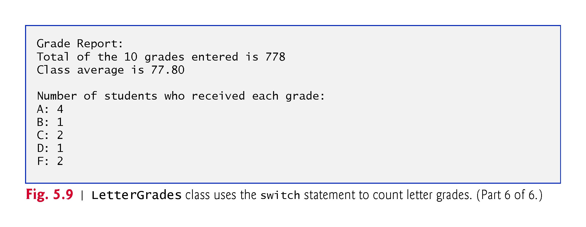

Slide 61
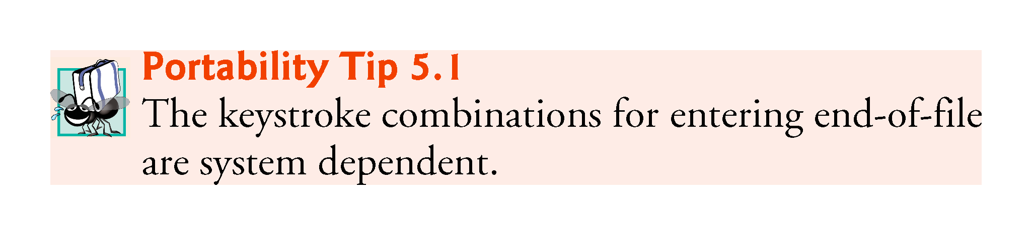

Slide 62
5.6 switch Multiple-Selection Statement (Cont.)
Scanner method hasNext determine whether there is more data to input. This method returns the boolean value true if there is more data; otherwise, it returns false.
As long as the end-of-file indicator has not been typed, method hasNext will return true.

Slide 63
5.6 switch Multiple-Selection Statement (Cont.)
The switch statement consists of a block that contains a sequence of case labels and an optional default case.
The program evaluates the controlling expression in the parentheses following keyword switch.
The program compares the controlling expression’s value (which must evaluate to an integral value of type byte, char, short or int, or to a String) with each case label.
If a match occurs, the program executes that case’s statements.
The break statement causes program control to proceed with the first statement after the switch.

Slide 64
5.6 switch Multiple-Selection Statement (Cont.)
switch does not provide a mechanism for testing ranges of values—every value must be listed in a separate case label.
Note that each case can have multiple statements.
switch differs from other control statements in that it does not require braces around multiple statements in a case.
Without break, the statements for a matching case and subsequent cases execute until a break or the end of the switch is encountered. This is called “falling through.”
If no match occurs between the controlling expression’s value and a case label, the default case executes.
If no match occurs and there is no default case, program control simply continues with the first statement after the switch.

Slide 65
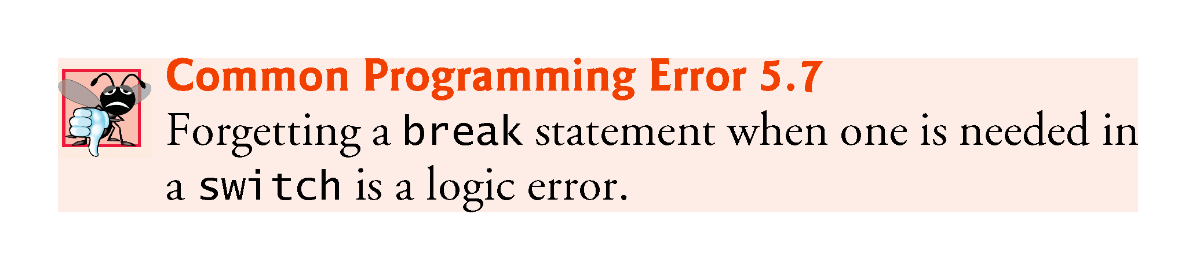

Slide 66
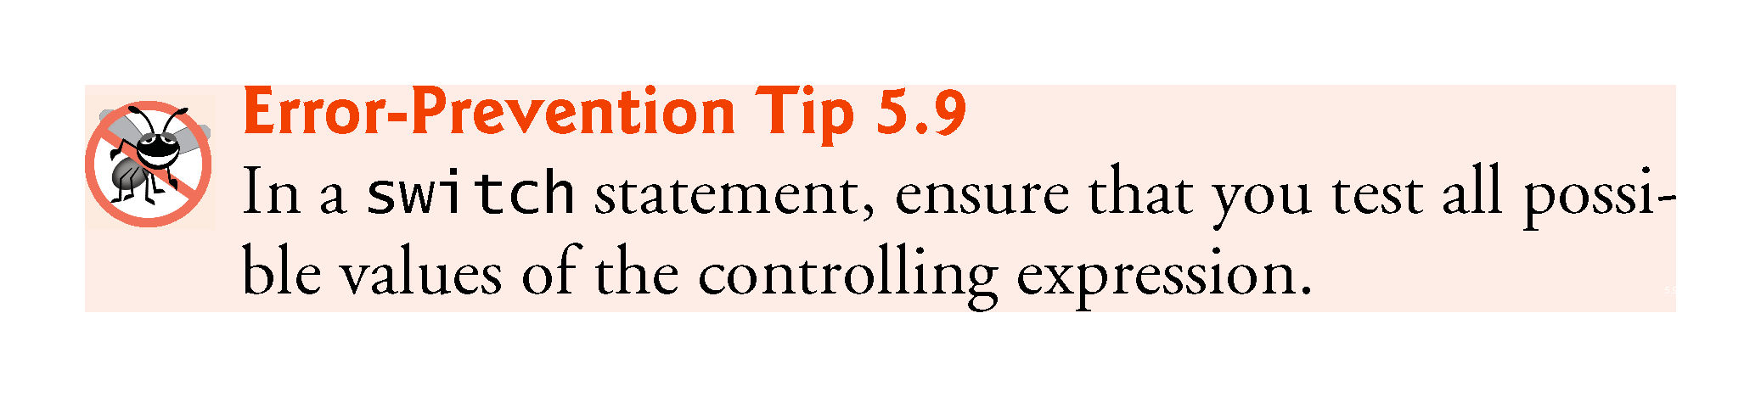

Slide 67
5.6 switch Multiple-Selection Statement (Cont.)
Figure 5.10 shows the UML activity diagram for the general switch statement.
Most switch statements use a break in each case to terminate the switch statement after processing the case.
The break statement is not required for the switch’s last case (or the optional default case, when it appears last), because execution continues with the next statement after the switch.

Slide 68
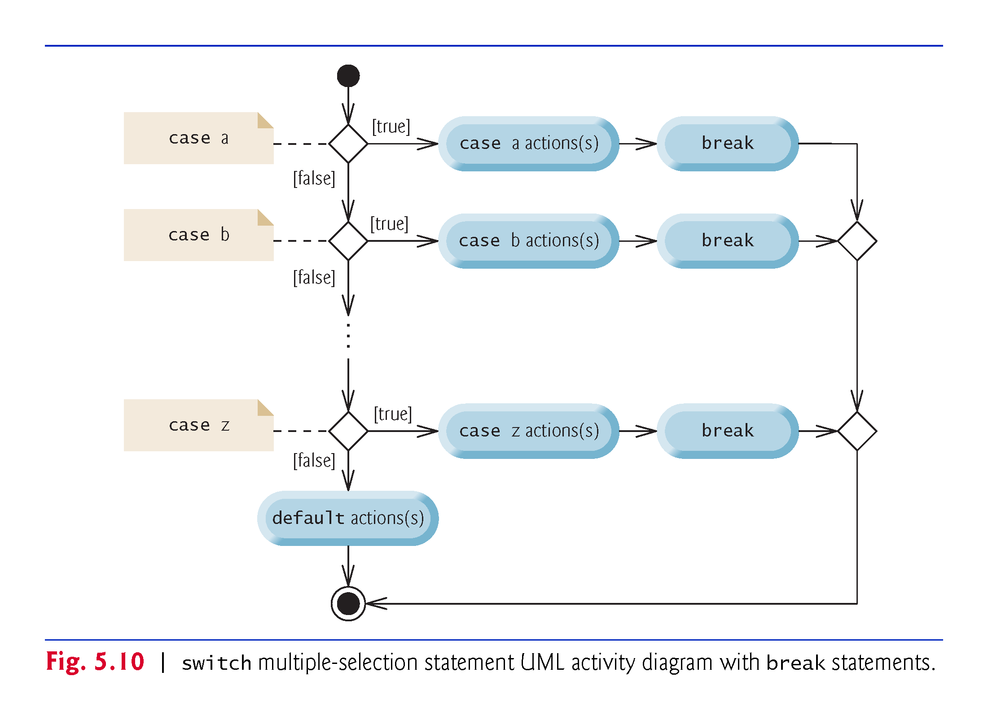

Slide 69
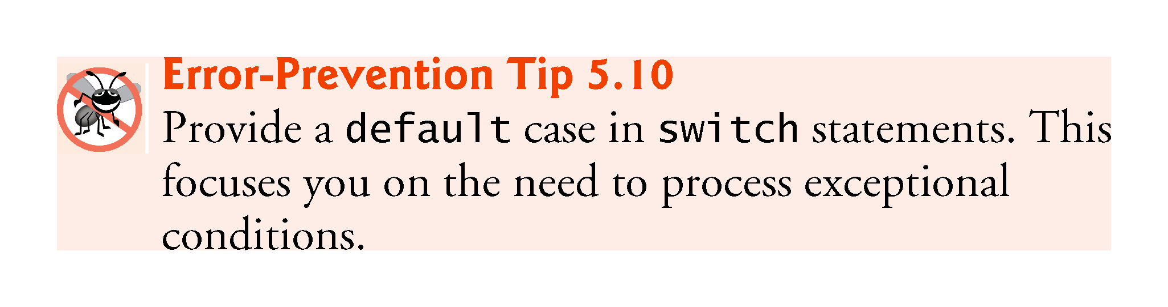

Slide 70
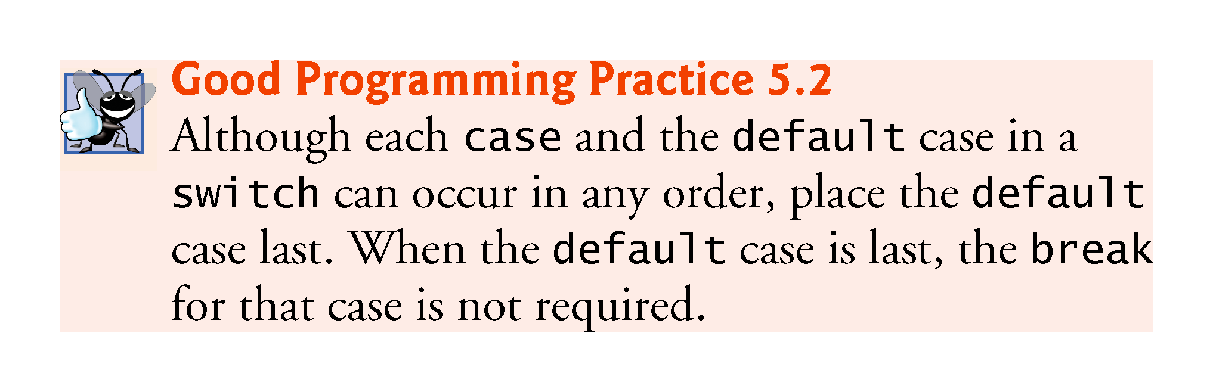

Slide 71
5.6 switch Multiple-Selection Statement (Cont.)
When using the switch statement, remember that each case must contain a constant integral expression.
An integer constant is simply an integer value.
In addition, you can use character constants—specific characters in single quotes, such as 'A', '7' or '$'—which represent the integer values of characters.
The expression in each case can also be a constant variable—a variable that contains a value which does not change for the entire program. Such a variable is declared with keyword final.
Java has a feature called enum types—enum type constants can also be used in case labels.

Slide 72
5.7 Class AutoPolicy Case Study: Strings in switch Statements
Strings can be used as controlling expressions in switch statements, and String literals can be used in case labels.
App requirements:
You’ve been hired by an auto insurance company that serves these northeast states—Connecticut, Maine, Massachusetts, New Hampshire, New Jersey, New York, Pennsylvania, Rhode Island and Vermont. The company would like you to create a program that produces a report indicating for each of their auto insurance policies whether the policy is held in a state with “no-fault” auto insurance—Massachusetts, New Jersey, New York and Pennsylvania.

Slide 73
5.7 Class AutoPolicy Case Study: Strings in switch Statements (Cont.)
Class AutoPolicy represents an auto insurance policy. The class contains:
int instance variable accountNumber to store the policy’s account number
String instance variable makeAndModel to store the car’s make and model (such as a "Toyota Camry")
String instance variable state to store a two-character state abbreviation representing the state in which the policy is held (e.g., "MA" for Massachusetts)
a constructor that initializes the class’s instance variables

Slide 74
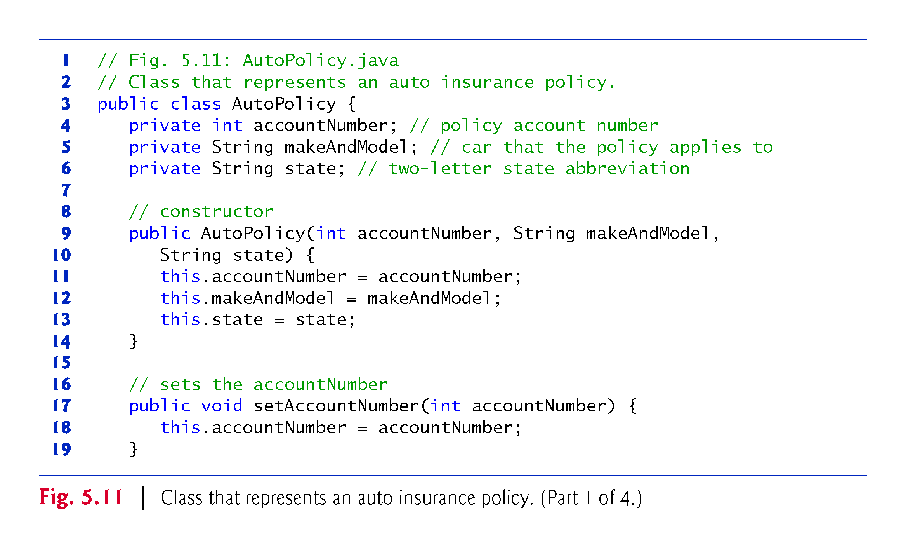

Slide 75
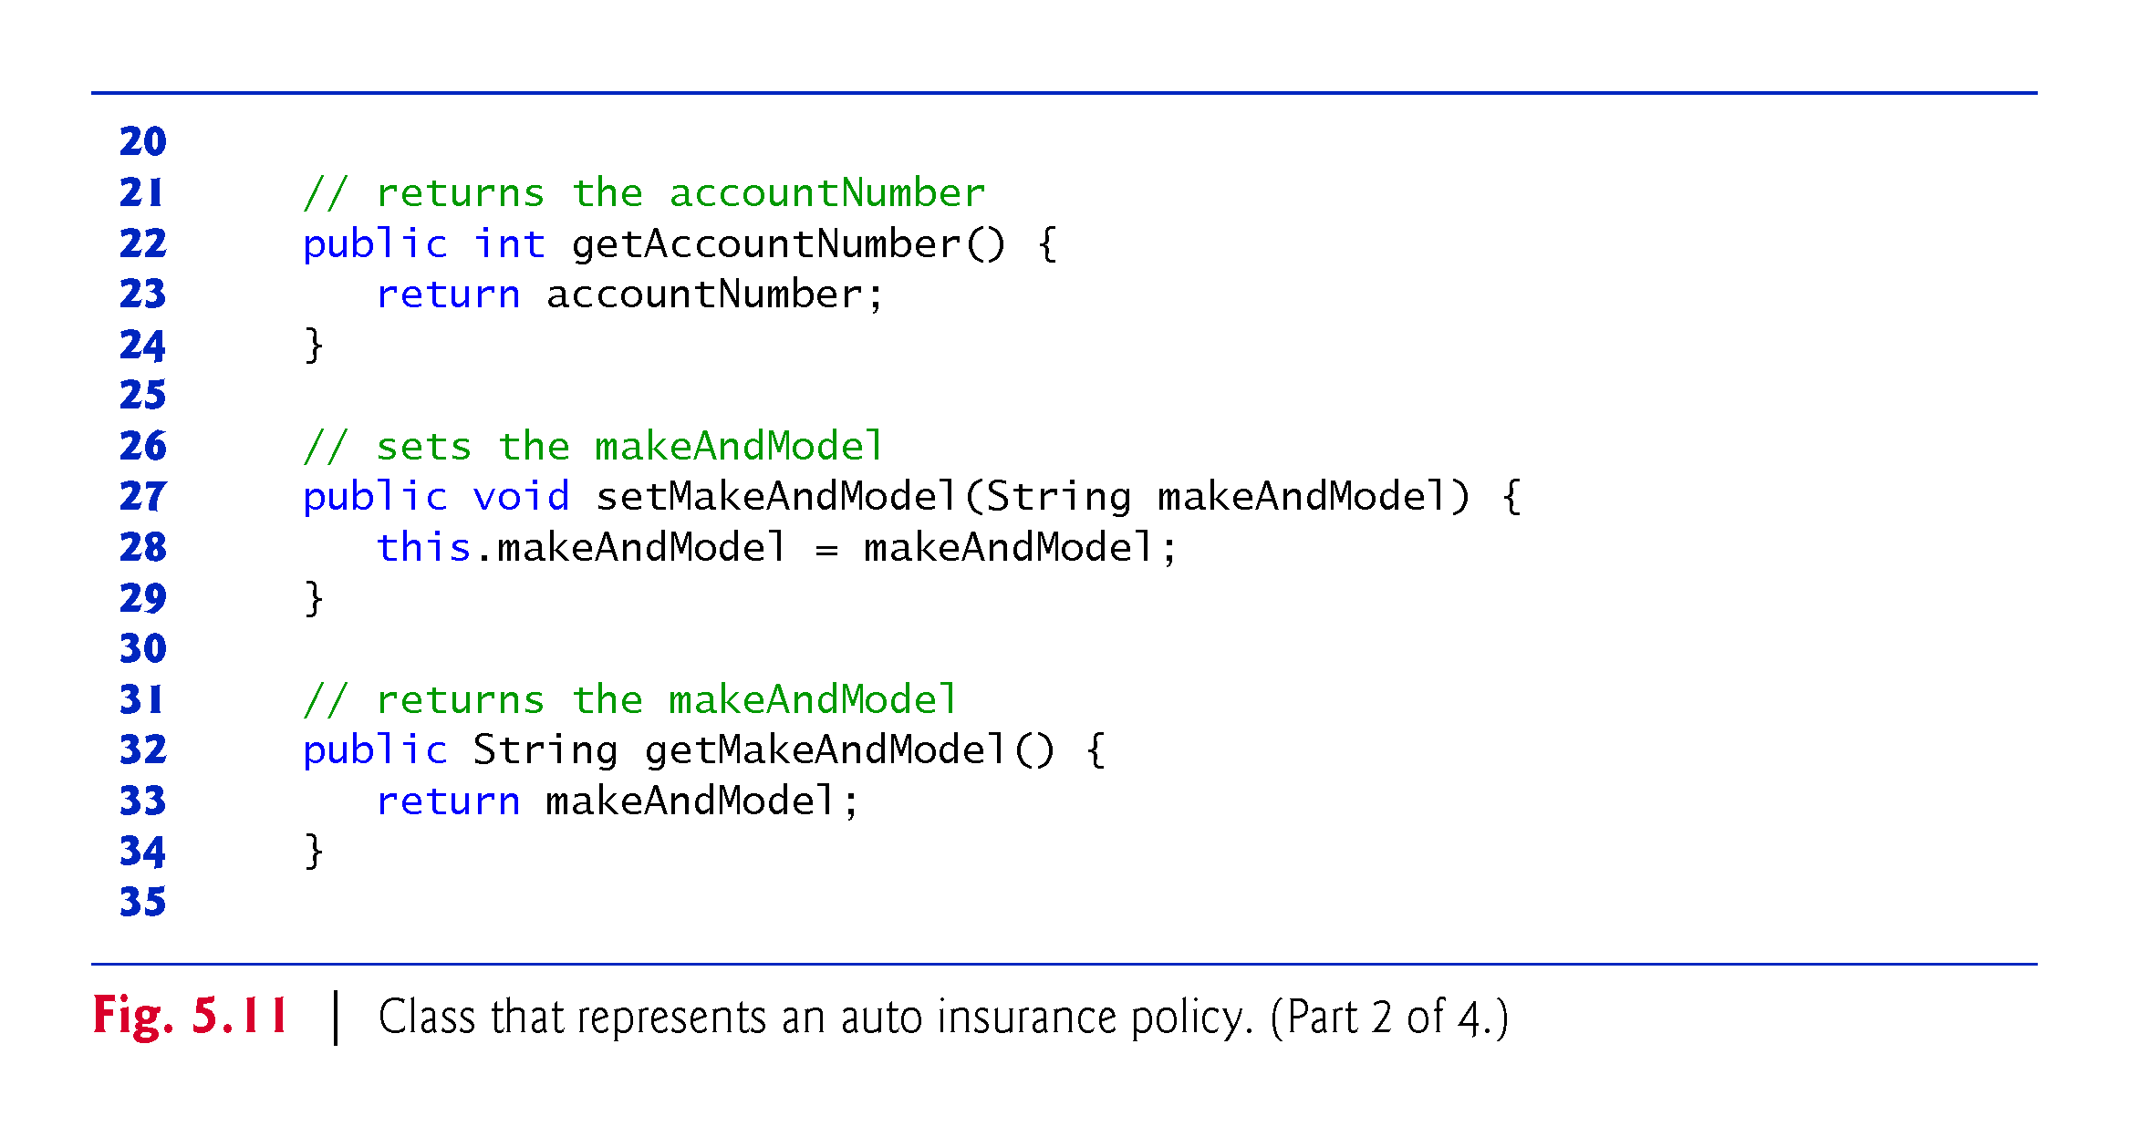

Slide 76
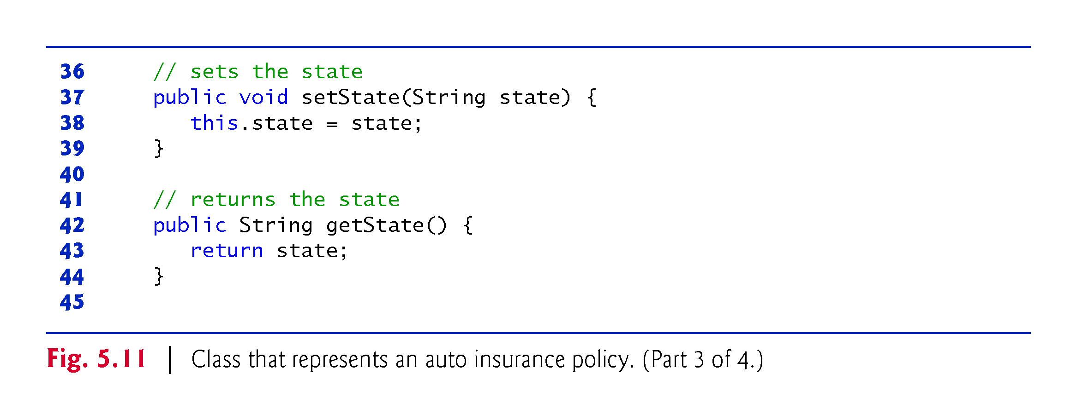

Slide 77
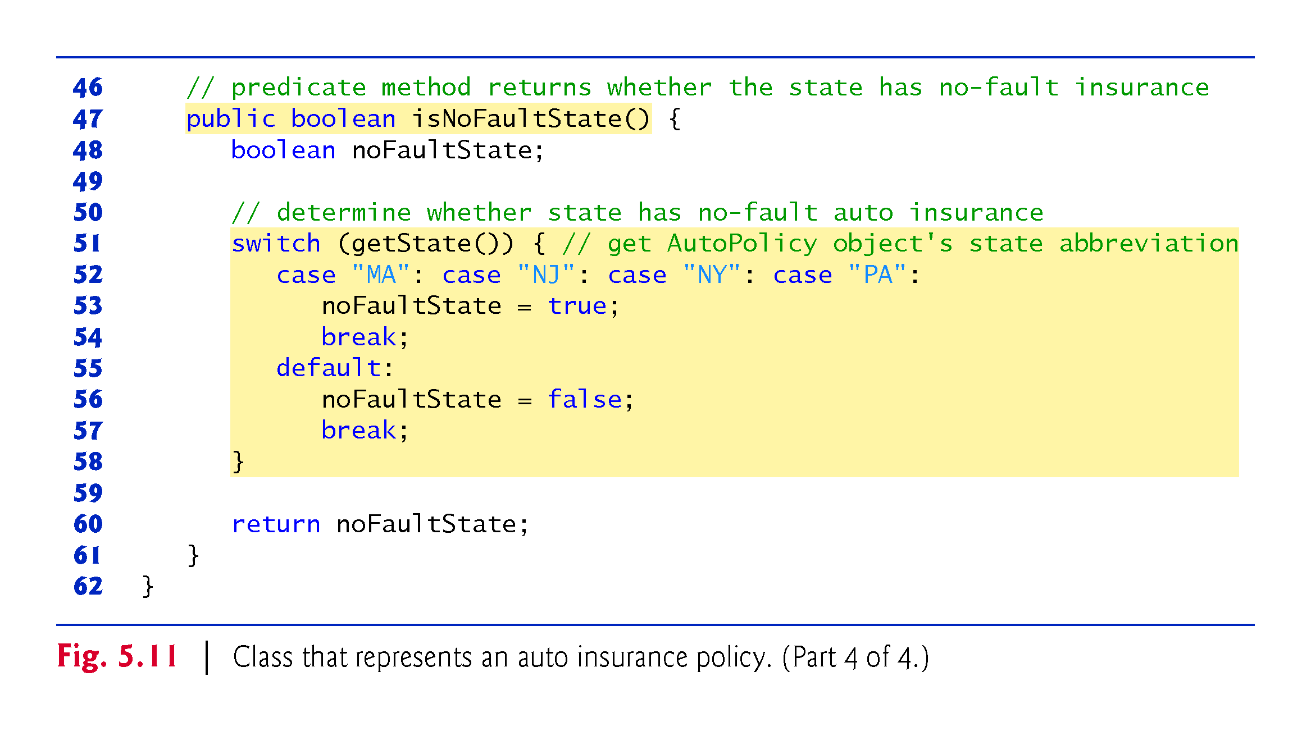

Slide 78
5.7 Class AutoPolicy Case Study: Strings in switch Statements (Cont.)
methods setAccountNumber and getAccountNumber to set and get an AutoPolicy’s accountNumber instance variable
methods setMakeAndModel and getMakeAndModel to set and get an AutoPolicy’s makeAndModel instance variable
methods setState and getState to set and get an AutoPolicy’s state instance variable
method isNoFaultState to return a boolean value indicating whether the policy is held in a no-fault auto insurance state; note the method name—the naming convention for a get method that returns a boolean value is to begin the name with "is" rather than "get" (such a method is commonly called a predicate method).

Slide 79
5.7 Class AutoPolicy Case Study: Strings in switch Statements (Cont.)
Class AutoPolicyTest (Fig. 5.12) creates two AutoPolicy objects.

Slide 80
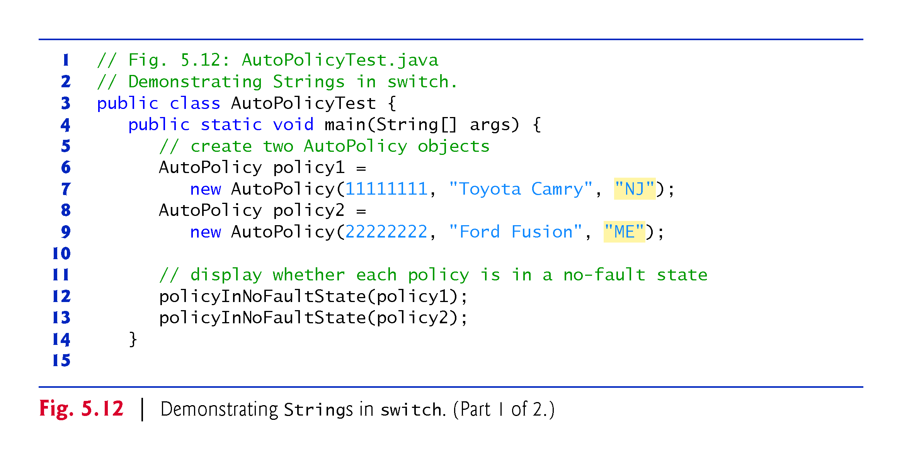

Slide 81
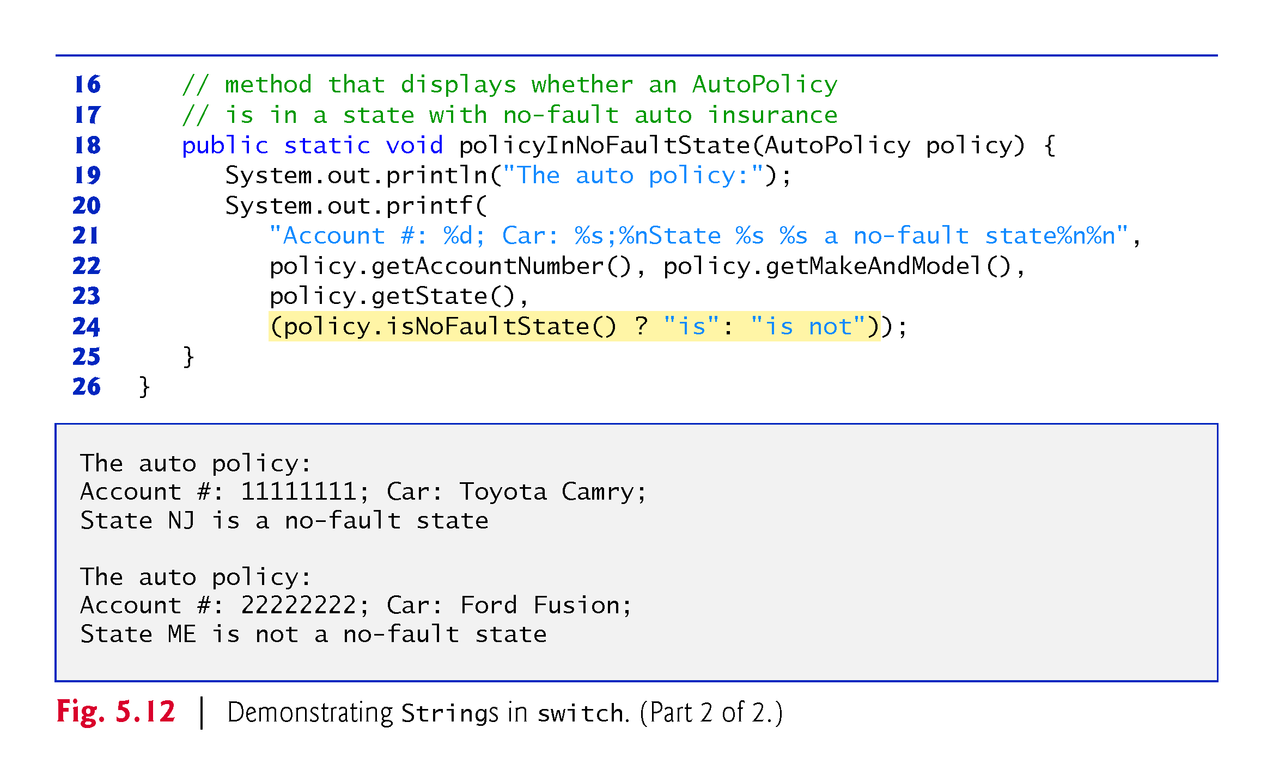

Slide 82
5.8 break and continue Statements
The break statement, when executed in a while, for, do…while or switch, causes immediate exit from that statement.
Execution continues with the first statement after the control statement.
Common uses of the break statement are to escape early from a loop or to skip the remainder of a switch.

Slide 83
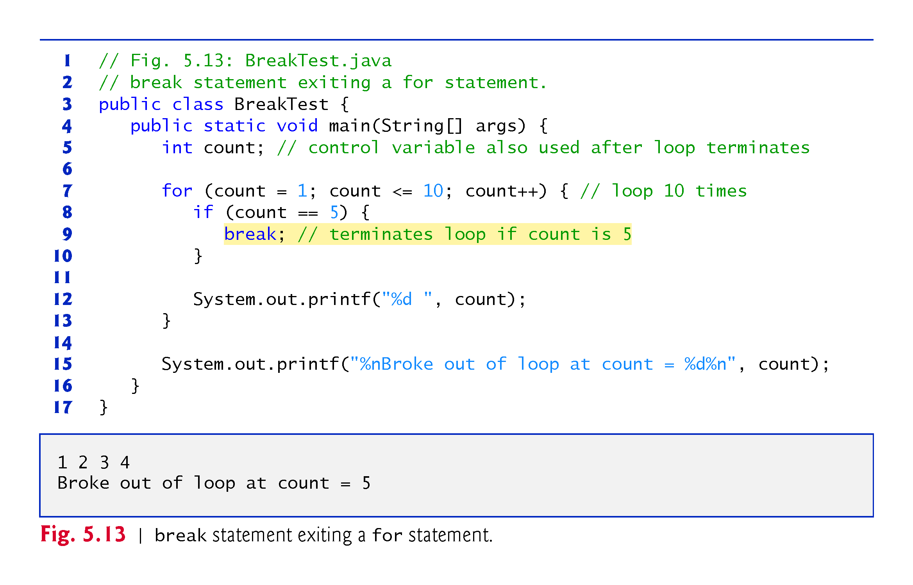

Slide 84
5.8 break and continue Statements (Cont.)
The continue statement, when executed in a while, for or do…while, skips the remaining statements in the loop body and proceeds with the next iteration of the loop.
In while and do…while statements, the program evaluates the loop-continuation test immediately after the continue statement executes.
In a for statement, the increment expression executes, then the program evaluates the loop-continuation test.

Slide 85


Slide 86


Slide 87


Slide 88
5.9 Logical Operators
Java’s logical operators enable you to form more complex conditions by combining simple conditions.
The logical operators are
&& (conditional AND)
|| (conditional OR)
& (boolean logical AND)
| (boolean logical inclusive OR)
^ (boolean logical exclusive OR)
! (logical NOT).
[Note: The &, | and ^ operators are also bitwise operators when they are applied to integral operands.]

Slide 89
5.9 Logical Operators (Cont.)
The & (conditional AND) operator ensures that two conditions are both true before choosing a certain path of execution.
The table in Fig. 5.15 summarizes the && operator. The table shows all four possible combinations of false and true values for expression1 and expression2.
Such tables are called truth tables. Java evaluates to false or true all expressions that include relational operators, equality operators or logical operators.

Slide 90


Slide 91
5.9 Logical Operators (Cont.)
The || (conditional OR) operator ensures that either or both of two conditions are true before choosing a certain path of execution.
Figure 5.16 is a truth table for operator conditional OR (||).
Operator && has a higher precedence than operator ||.
Both operators associate from left to right.

Slide 92


Slide 93
5.9 Logical Operators (Cont.)
The parts of an expression containing && or || operators are evaluated only until it’s known whether the condition is true or false. T
This feature of conditional AND and conditional OR expressions is called short-circuit evaluation.

Slide 94


Slide 95
5.9 Logical Operators (Cont.)
The boolean logical AND (&) and boolean logical inclusive OR (|) operators are identical to the && and || operators, except that the & and | operators always evaluate both of their operands (i.e., they do not perform short-circuit evaluation).
This is useful if the right operand has a required side effect—a modification of a variable’s value.

Slide 96


Slide 97


Slide 98
5.9 Logical Operators (Cont.)
A simple condition containing the boolean logical exclusive OR (^) operator is true if and only if one of its operands is true and the other is false.
If both are true or both are false, the entire condition is false.
Figure 5.17 is a truth table for the boolean logical exclusive OR operator (^).
This operator is guaranteed to evaluate both of its operands.

Slide 99


Slide 100
5.9 Logical Operators (Cont.)
The ! (logical NOT, also called logical negation or logical complement) operator “reverses” the meaning of a condition.
The logical negation operator is a unary operator that has only one condition as an operand.
The logical negation operator is placed before a condition to choose a path of execution if the original condition (without the logical negation operator) is false.
In most cases, you can avoid using logical negation by expressing the condition differently with an appropriate relational or equality operator.
Figure 5.18 is a truth table for the logical negation operator.

Slide 101


Slide 102
5.9 Logical Operators (Cont.)
Figure 5.19 produces the truth tables discussed in this section.
The %b format specifier displays the word “true” or the word “false” based on a boolean expression’s value.

Slide 103


Slide 104


Slide 105


Slide 106


Slide 107


Slide 108


Slide 109
5.10 Structured Programming Summary
Figure 5.21 uses UML activity diagrams to summarize Java’s control statements.
Java includes only single-entry/single-exit control statements—there is only one way to enter and only one way to exit each control statement.
Connecting control statements in sequence to form structured programs is simple. The final state of one control statement is connected to the initial state of the next—that is, the control statements are placed one after another in a program in sequence. We call this control-statement stacking.
The rules for forming structured programs also allow for control statements to be nested.

Slide 110


Slide 111


Slide 112


Slide 113


Slide 114


Slide 115


Slide 116


Slide 117
5.10 Structured Programming Summary (Cont.)
Structured programming promotes simplicity.
Bohm and Jacopini: Only three forms of control are needed to implement an algorithm:
sequence
selection
iteration
The sequence structure is trivial. Simply list the statements to execute in the order in which they should execute.

Slide 118
5.10 Structured Programming Summary (Cont.)
Selection is implemented in one of three ways:
if statement (single selection)
if…else statement (double selection)
switch statement (multiple selection)
The simple if statement is sufficient to provide any form of selection—everything that can be done with the if…else statement and the switch statement can be implemented by combining if statements.

Slide 119
5.10 Structured Programming Summary (Cont.)
Iteration is implemented in one of four ways:
while statement
do…while statement
for statement
Enhanced for statement
The while statement is sufficient to provide any form of iteration. Everything that can be done with do…while and for can be done with the while statement.

Slide 120
5.10 Structured Programming Summary (Cont.)
Combining these results illustrates that any form of control ever needed in a Java program can be expressed in terms of
sequence
if statement (selection)
while statement (iteration)
and that these can be combined in only two ways—stacking and nesting.

Slide 121
5.11 (Optional) GUI and Graphics Case Study: Drawing Rectangles and Ovals

Slide 122


Slide 123


Slide 124


Slide 125


Slide 126


Slide 127


